Slide 1
CS/EE/ME 75(C): Week 4 (5)
House Keeping:
  Course Zoom Link: https://caltech.zoom.us/j/282171019
  Is everyone up-to-date on tutorials?
  Time to start organizing team meetings again…..
Let’s start simulating!
Initial Goals
  Build a SDF model of your team’s vehicle
  Integrate your model with a Gazebo “empty world.” Show that you can send constant commands to your simulated vehicle from the Gazebo interface.
  Find/build a ROS joystick node
  Connect a joystick (or keyboard) input from ROS to your gazebo simulation

Slide 2
CS/EE/ME 75(C): Week 4 (5)
2) Intermediate Goals
  Choose the simplest existing ROS controller that is compatible with your team vehicle
  Add basic sensors to your vehicle (as needed to close the first loop on the vehicle).
  Demonstrate closed loop performance of your vehicle under ROS control
  Integrate, if needed, other exteroceptive sensors (Lidar and Intel Real Sense)
3) Final goals
  Develop/adapt autonomy to your system
  Integrate into the JPL simulator?

Slide 3
CS/EE/ME 75(C): Week 4 (5)
First guiding philosophy
  Do NOT reinvent any wheels
  Uses, modify, adapt as much existing code and plugin libraries as possible.
Drive-o-copter team:
  The existing “hector quadrotor” ROS package may be a good place to start
  http://wiki.ros.org/hector_quadrotor
  There is also a tutorial on how to map an indoor space using the hector quadrotor model: http://wiki.ros.org/hector_quadrotor/Tutorials/Quadrotor%20indoor%20SLAM%20demo
    This demo was last updated in 2018, so there are probably a few bits of ROS software rot that you will have to overcome

Slide 4
CS/EE/ME 75(C): Week 4 (5)
First guiding philosophy
  Do NOT reinvent any wheels
  Uses, modify, adapt as much existing code and plugin libraries as possible.
  Check the ROS page on existing ROS code for specific vehicles:
    https://robots.ros.org/#UAVs
Drive-o-copter team:
  The existing “hector quadrotor” ROS package may be a good place to start
  http://wiki.ros.org/hector_quadrotor
  There is already a “teleoperation” node for this quadrotor simulation:
    http://wiki.ros.org/hector_quadrotor_teleop
  There is also a tutorial on how to map an indoor space using the hector quadrotor model: http://wiki.ros.org/hector_quadrotor/Tutorials/Quadrotor%20indoor%20SLAM%20demo
    This demo was last updated in 2014, so there are probably a few bits of ROS software rot that you will have to overcome
  Also check the ROS page dedicated to UAV projects: https://www.ros.org/news/robots/uavs/

Slide 5
CS/EE/ME 75(C): Week 4 (5)
Autonomous RC Car team:
  The f1tenth project (tenth-scale autonomous RC Car formula 1 racing) is probably the best starting point for code to borrow.
  https://f1tenth.dev/
  Note that it uses ROS melodic and Gazebo 9, so there should not be too many issues with out-of-date ROS commands, packages, libraries, etc.
  Essentially the entire project is hosted on GitHub, which should allow easier development and modification: https://github.com/f1tenth-dev/simulator/wiki/Installation
  There is already a “teleoperation” node for this quadrotor simulation:

Slide 6
A simulator can mimic many (but not all) aspects of a real world robot deployment
  Simulate robot geometry & movements
  Simulate obstacles, objects in the robot’s environment
  Simulate sensor readings and sensor feedback process
  Simulate physical interactions between objects
    Most difficult & sensitive simulation
Why use simulation?
  Debug code before testing it in high-cost-of-failure real world situations
  Test on hardware which is not available
  Allow for parallel development across sub-teams
  Create visualization videos

Slide 7
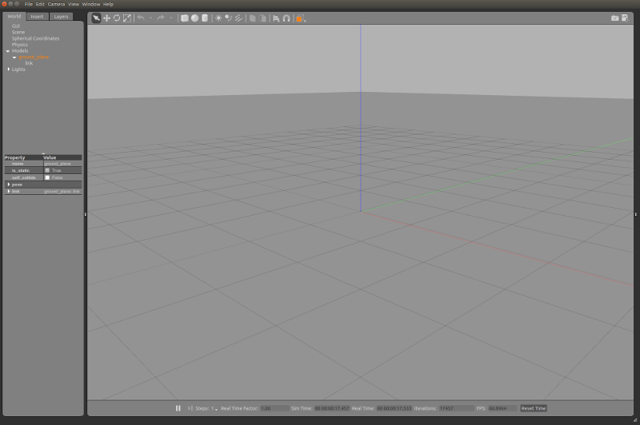
Gazebo Simulation Architecture
Worlds: Contains all simulation elements
  Robots, Static Objects
  Sensors, Lights
Models: describe the robot
  Geometry, kinematics of links
    Appearance
    collision
  dynamic parameters (for sim
  visual appearance
  Interface information
Sensors: locations & sensor type
Plugins: allow programmed interaction with simulation elements
Gazebo implemented as a simulation server and a GUI client

Slide 8
General Gazebo/ROS Simulation Workflow (updated)
  Launch a world into Gazebo:
    The launch starts up the world model in Gazebo, as well as the nodes that will control a real robot. But now they control a simulated robot.
  The last lecture was about Gazebo’s worlds, and how to start them within a simulation.
  This lecture summarizes how we can define feedback control systems in ROS, and what we must do to allow these closed loop systems to operate in simulation.
    Plugins: allow interaction between ROS & Gazebo
    ROS Control

Slide 9
Gazebo Plugins
Why a Plugin?
  We need a way for ROS (or other external programs) to modify the Gazebo simulated worlds
    Send torques to the simulated robots’ motors. The “physics engine” then uses its kinematic/dynamic models to predict how the robot will move under the commands
    Change lighting conditions or other states/parameters of the simulated world
  The external programs need a way to access the states of the simulated world and robots
    Sense the current simulated values of the robot joint variables
    Get the data streamed from the simulated exteroceptors, such as simulated cameras, lidars, ultrasound, etc.
What is a Plugin?
  Implemented as a shared library
  Dynamically linked (at load time) to Gazebo and ROS
  Often invoked during launch. But can be loaded/removed any time.

