Slide 1
DARPA Subterranean Challenge “Software” Projects (first version)

Slide 2
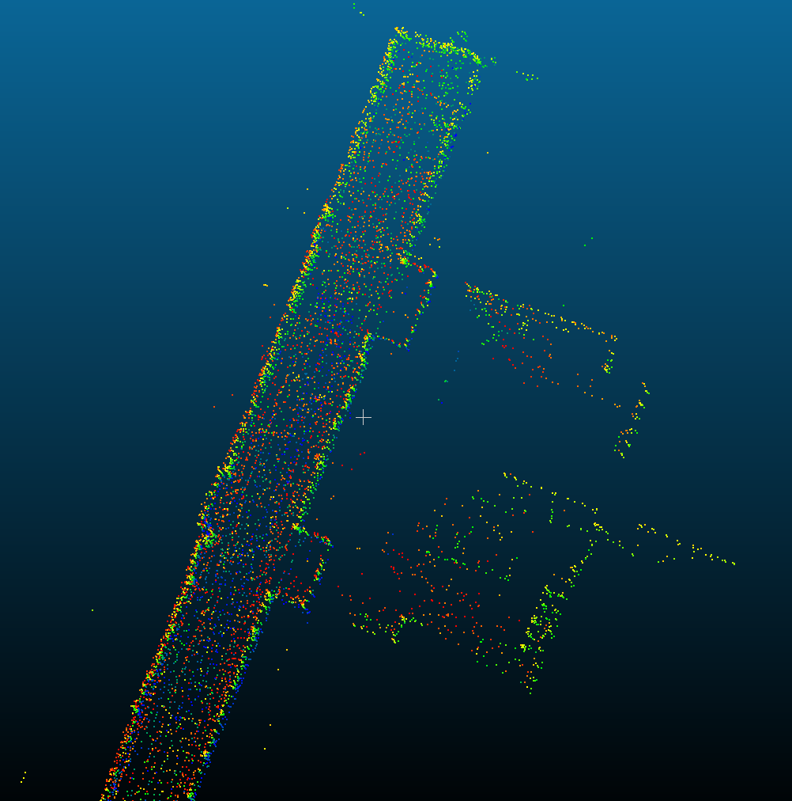
Lego-LOAMS Projects Background
LeGo-LOAMS is a public-domain code for visual odometry and local map making that we will use for the foreseeable future.
In Visual Odometry (VO), two LiDAR scans of the robot’s environment are take in successive (and nearby) robot locations. The scan features are matched across the two data scans in order to estimate the robot’s displacement between the adjacent locations (hence the term odometry). Based on the odometry estimates, a local map of the environment is made.
We want to make several improvements to LeGO-LOAMS

Slide 3
Project: Lego-LOAMS #1: IMU Fusion
Goal: Develop an estimator (e.g. Kalman Filter or particle filter) that “fuses” IMU data with the Visual Odometry Estimates
Motivation: The fusion of these two forms of prioprioception produces better maps. Currently, LeGO-LOAMS use of an IMU (Inertial Measurement Unit) is very unsophisticated.
Activity: Develop an estimator that fuses these two streams of sensor data, and test on a ground or aerial vehicle.
Contacts:
Caltech: Anushri Dixit, adixit@caltech.edu, Joel Burdick, jwb@robotics.caltech.edu

Slide 4
Project: Lego-LOAMS #2: Improved Feature Extraction
Goal: Develop a better feature extractor to find planes (e.g., walls, ceilings, floors) in the LiDAR return signals, and other useful features.
Motivation: When features are present in LiDAR data, they can be used to improve VO estimates and map quality. Planes are a common feature in man-made environments. We can think that we can improve LeGO-LOAMS feature detector.
Activity: Develop and feature extractors for Velodyne LiDARS, and test them on vehicles
Contacts:
Caltech: Anushri Dixit, adixit@caltech.edu, Joel Burdick, jwb@robotics.caltech.edu

Slide 5
Project: Lego-LOAMS #3: Aerial Version
Goal: Modify LeGO-LOAMS so that it works with flying vehicles.
Motivation: LeGO-LOAMS was developed for ground robots. Several of its algorithms take shortcuts, or modify the analysis to make the VO and map estimates appropriate for ground vehicles. We would like to make a version which works for aerial vehicles.
Activity: Understand LeGO-LOAMS implicit biases to ground robots, and upgrade it to work with aerial vehicles. Test on aerial vehicles.
Contacts:
Caltech: Anushri Dixit, adixit@caltech.edu, Joel Burdick, jwb@robotics.caltech.edu

Slide 6
Project: Lego-LOAMS #4: Multi-Robot Mapping
Goal: Develop a multi-robot version of LeGO-LOAMS.
Motivation: LeGO-LOAMS is currently focused on incorporating data from a single robot. To map a large space, we must integrate the data from all vehicles and their heterogeneous sensors into a coherent, unified map.
Activity: Develop a Multi-Robot mapping algorithm that uses the GT-SAM and LeGO-LOAMS framework. This is Ph.D.-level research.
Contacts:
Caltech: Anushri Dixit, adixit@caltech.edu, Joel Burdick, jwb@robotics.caltech.edu

Slide 7
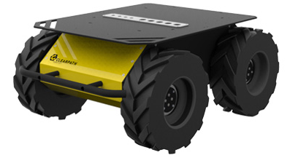
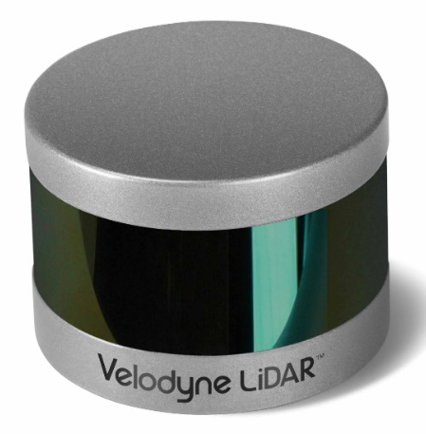
Project: Ground Robot Motion Planning System
Goal: Develop a local motion planner for a Husky robot equipped with a Velodyne LiDAR, IMU, and Intel Real-Sense sensors. The planner should take a target location input from a human operator (usually a few 10’s of meters away), and construct/execute a collision-free path to the goal.
Motivation: During the SubT competition, ground robots must autonomously reach targets given by the human operator
Activity: Start with an existing ROS planning package, and adapt as necessary for the Husky robots.
Contacts:
Caltech: Drew Singletary (grad student): drewsingletary1@gmail.com
JPL: Ali Agha (team lead): aliakbar.aghamohammadi@jpl.nasa.gov

