Slide 1
CS/EE/ME 75(C): Week 3 (4)
(with revised homework)
House Keeping:
Course Zoom Link: https://caltech.zoom.us/j/282171019
Maybe another tutorial session on Friday?
1) Our goal: Develop simulations for RC Car and Drive-o-copter
Many control, planning, autonomy algorithms can be simulated
Will simplify eventual integration.
2) First Steps
Learn how to simulate using Gazebo, and visualize using RViz
Write an SDF for Gazebo, which will create an URDF for Rviz

Slide 2
A simulator can mimic many (but not all) aspects of a real world robot deployment
Simulate robot geometry & movements
Simulate obstacles, objects in the robot’s environment
Simulate sensor readings and sensor feedback process
Simulate physical interactions between objects
Most difficult & sensitive simulation
Why use simulation?
Debug code before testing it in high-cost-of-failure real world situations
Test on hardware which is not available
Allow for parallel development across sub-teams
Create visualization videos

Slide 3
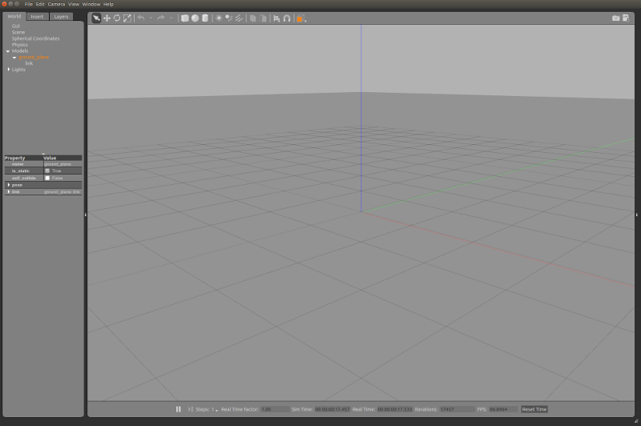
Gazebo Simulation Architecture
Gazebo has two main parts/processes:
Server: Runs the physical simulation of the model world, and generates sensor signals/data
gzserver
Libraries: Transport, Sensors, Transport, Rendering
Client: Provides user interaction and visualization
gzclient
Libraries: Transport, Sensors, Transport, Rendering
Gazebo: run both gzserver & gzclient
See tutorial at: http://gazebosim.org/tutorials?tut=guided_b2&cat=

Slide 4
Elements of a Gazebo Simulation
World:
Collection of models, lights, plug-ins and global parameters (that affect everything in the world)
Model:
Collection of links (rigid bodies), joints, sensors, meshes (surface texture/color) and lights.
Link(s):
Visual and Collision geometry of objects
Joints:
Defines the constraints between links
Visual Object:
Defines the geometry that is visualized in the GUI rendering
Collision Object:
Defines geometry that is checked in physics simulation for collision
Sensor(s):
Objects that collect, possiblyl process, and transmit data
Plugins:
Bits of code that are embedded in simulations

Slide 5
Models
A Model contains key properties
Physical presence:
Sphere, box, combination of shapes
Kinematics: Joints & velocities
Dynamics: mass, inertia friction, forces (e.g., gravity)
Interface (optional)
Control & feedback interface (libgazebo)
A Model is described by two files
Config file: model.config
SDF file: <modelname>.sdf
Locations: /usr/share/gazebo-9/models/ (* standard gazebo models)
~/.gazebo/models/

Slide 6
Models
<?xml version='1.0'?>
<sdf version="1.4">
<model name=“box.sdf">
<pose>0 0 0.5 0 0 0</pose> <!– origin -->
<static>true</static>
<link name="link">
<inertial>
<mass>1.0</mass>
<inertia> <!-- inertias -->
<ixx>0.083</ixx>
<ixy>0.0</ixy>
<ixz>0.0</ixz>
<iyy>0.083</iyy>
<iyz>0.0</iyz>
<izz>0.083</izz>
</inertia>
</inertial>
<?xml version="1.0"?>
<model>
<name>The Box Model</name>
<version>1.0</version>
<sdf version='1.5'>box.sdf</sdf>
<author>
<name>Joel Burdick</name>
<email>jburdick@caltech.edu</email>
</author>
<description>
The Box Tutorial Model
</description>
</model>
<collision name="collision">
<geometry>
<box>
<size>1 1 1</size>
</box>
</geometry>
</collision>
<visual name="visual">
<geometry>
<box>
<size>1 1 1</size>
</box>
</geometry>
</visual>
</link>
</model>
</sdf>
~/.gazebo/models/box/box.sdf
~/.gazebo/models/box/model.config

Slide 7
Element Types in Models
Visual Geometry
Physical appearance
Simple Shapes: Sphere, box, shape combinations
Complex Shapes: height maps, meshes
Collision Geometry
Shape used in physics simulation to check for interference, and model interaction forces
Shape used for motion planning collision check
Visual and shape geometries can be the same
Usually, collision geometry is chosen as a simple bounding shape

Slide 8
Element Types in Models
Joints
Prismatic: 1 DOF “slider” joint allows translation
Revolute: 1 DOF “hinge” joint allows rotation
Revolute2: Two revolute joints in series
Ball: 3 DOF “ball joint” (spherical joint)
Universal: 2 DOF joint
Screw: 1 DOF “helical” joint (threaded rod)
Simple Shapes: Sphere, box, shape combinations
Complex Shapes: height maps, meshes
bounding shape

Slide 9
Element Types in Models
Sensors
Ray: produces range data, like a Lidar
Camera:
Simulate 2D camera
Simulate 2D stereo cameras
Simulate 3D RGB-D (like Kinect)
Contact (“bump” sensor)
Lights
Point Light: Omnidirectional source, like a light bulb
Spot: Directional cone of light (spot light)
Directional: parallel rays, like the sun

Slide 10
Worlds
Composed of a model hierarchy
Gazebo server (gzserver) reads/parses a gazebo “world file” to generate and populate a world
Formulated in Simulation Description Format (SDF) XML. Can also take URDF (which is then upgraded to SDF)
File has a “.world” extension
Contains all of the elements in a simulation
Robots
Static Objects
Lights,
Sensors
Existing Gazebo Worlds: /usr/share/gazebo-9/worlds/

Slide 11
General Gazebo/ROS Simulation Workflow
Steps
Load a world:
Gazebo <yourworld>.world &
No ROS interface
Roslaunch gazebo_ros <your_world>.launch &
gazebo_ros can be replaced by other package names
If you command the simulation from ROS
If you want to use Rviz to view sensor output
Robot(s) get “spawned” into the world
There are multiple ways to do this
Joint, robot states, sensor data are published
Run Rviz, and subscribe to simulation data topics

Slide 12
Homework: Week (3) 4
(revised homework from week 2 (3) )
Goal: become competent with Gazebo
NOTE: Gazebo 9 is already installed in Ubuntu 18.1
Read: “Beginner GUI” to get a sense of the Gazebo user interface layout
http://gazebosim.org/tutorials?tut=guided_b2&cat=
Next, visit the Gazebo “Build a Robot Tutorials” : http://gazebosim.org/tutorials?cat=build_robot . Complete the following tutorial steps under “Build a Robot”
Read the “model structure and requirements” link: http://gazebosim.org/tutorials?tut=model_structure&cat=build_robot
When you “clone” the githhub repository of Gazebo models (in the “The Model Database Repository” section), make sure the model directories get copied into /usr/share/gazebo-9/models/ directory
Read the “Make a Model” tutorial section http://gazebosim.org/tutorials?tut=build_model&cat=build_robot
Create the “box.sdf” example. See the next page for instructions on how to insert the model into gazebo through the GUI interface

Slide 13
Homework: Week 2 (3)
(revised homework)
<?xml version="1.0"?>
<model>
<name>The Box Model</name>
<version>1.0</version>
<sdf version='1.5'>box.sdf</sdf>
<author>
<name>Joel Burdick</name>
<email>jburdick@caltech.edu</email>
</author>
<description>
The Box Tutorial Model
</description>
</model>
Read the “Make a Model” tutorial section (continued)
To insert the box into gazebo through the GUI interface, you must prepare the model for use in Gazebo:
Make a directory : mkdir ~/.gazebo/models/box
Put the box.sdf file in the box directory
Put a model.config file in the box directory. Here is my example in the box on the right
Start gazebo: gazebo &
In the left panel, click on the “Insert” tab.
You should see “The Box Model”under your models
Click on the box model, and position it in your world
~/.gazebo/models/box/model.config

Slide 14
Homework: Week 2 (3)
(revised homework)
“Make a mobile Robot”: http://gazebosim.org/tutorials?tut=build_robot
In this is a straightforward tutorial (it works with ROS melodic and the preinstalled gazebo-9.0.0 on Ubuntu 18.1) you will build a simple differential drive model
I found no errors in this tutorial
A lengthier version of this model-building exercise can also be found at:
“Beginner: Model Editor:” ”: http://gazebosim.org/tutorials?tut=guided_b3 . This version creates basic solid components using the model editor, instead of the text-based creation in the “make a mobile robot”
Carry out the “Attach Meshes” exercise (note, at the end of the “make a mobile robot” , there is a link to this exercise): http://gazebosim.org/tutorials?tut=attach_meshes&cat=build_robot
Carry out the “add a sensor” tutorial: http://gazebosim.org/tutorials?tut=add_laser&cat=build_robot

Slide 15
Homework: Week 2 (3)
(revised homework)
Visit the “Using a URDF in Gazebo” link on the tutorial page.
http://gazebosim.org/tutorials/?tut=ros_urdf
This tutorial is not so important, but it helps set up the following tutorials
Before starting this tutorial, you must update gazebo/ros as follows
Make sure that you are logged in as the super-user to your Ubuntu
In a shell: sudo apt update
In the same shell: sudo apt install ros-melodic-joint-state-publisher-gui
Don’t forget to properly set your ROS and gazebo paths:
In your catkin_ws space: source devel/setup.bash
In your catkin_ws space: source /usr/share/gazebo-9/setup.sh
The first important step in the tutorial is to carry out “Getting RRBot.” This model will be used in several steps
Then carry out the steps of “View in Rviz” and “View in Gazebo”
You can skim the rest of the tutorial

Slide 16
Homework: Week 2 (3)
(revised homework)
Visit the “Using Roslaunch” link on the tutorial page.
http://gazebosim.org/tutorials?tut=ros_roslaunch&cat=connect_ros
Before attempting this tutorial, you must take two steps:
Step #1: Change a line in the Gazebo 9 setup file: /usr/share/gazebo-9/setup.sh
Original: export GAZEBO_MODEL_DATABASE_URI=http://gazebosim.org/models
Corrected: export GAZEBO_MODEL_DATABASE_URI=http://models.gazebosim.org/
Step #2: Load the Linux paths that you will need to make the tutorial work as listed:
cd ~/catkin_ws
source devel/setup.bash % source your compiled packages
source /usr/share/gazebo-9/setup.sh % source paths needed by gazebo
Source /opt/ros/melodic/setup.sh % sources paths needed by ROS
Note: you can put these steps in your ~/.bashrc file so that these paths are loaded every time you start up a shell!

