Slide 1
CDS 112 Lecture 1 Course Overview/Organization
Joel Burdick, jwb@robotics.caltech.edu, X4139, Keck 205
Assistant: Sonya Lincoln, lincolns@caltech.edu, X3385,
T.A.: Matthew (Matt) Burkhardt, mburkhar@caltech.edu, Keck 208
Goals for Today:
Course administration for CDS 110b
Introduce modern (optimization-based) control system
Introduction to optimization
Conflicts?

Slide 2
Course Admin
Lectures:
MWF 1:00-1:55; Annenberg 107 (today). Then Annenberg 213 thereafter
Web page:
https://www.cds.caltech.edu/~murray/wiki/index.php/CDS_112,Winter_2015
Copies of any Notes handed out in class, Copies of lecture slides
Course text(s)
Reading assignments. Homeworks and their solutions (see Schedule page)
Course announcements, etc.
Course texts: (all free)
R. M. Murray, Optimization-based Control, 2010 Notes/Preprint (link on website)
B.D.O. Anderson & J.B. Moore, Optimal Filtering (link on website)
Others:
Doyle, Francis, Tannenbaum, Feedback Control Theory, (link on website)
Friedland, Control System Design, (in SFL)
Other reading: see website
Grading:
70% Homework: ~6 homeworks every ~10 days. Due at 5:00 pm (box outside 205 Keck) Two 2-day grace periods can be used any time during the quarter
30% Final: “open-book,” covering weeks 1-9

Slide 3
Control System Design: 110
Uncertainty
Δ
Output, y
Reference
Controller
Process
Design controller
Use process model, design in frequency domain (Bode, Nyquist)
Use process model, design in state-space with state feedback (pole placement)
Robustness to uncertainty
Intuitive, through phase & stability margins
Goals:
Stabilization to a point (maybe unstable equilibrium)
Tracking (follow simple reference trajectory, such as step input)
Disturbance rejection (maintain equilibrium despite disturbances)

Slide 4
Control System Design: 112
Δ
Trajectory
Generation
r
e
Controller
Process
Estimator
^
x
Design controller
Use process model, design in state-space with estimator and state feedback
Generalization of CDS 110 observer
Robustness to uncertainty
Formally, with rigorous analysis (CDS 212-213)
Goals:
Stabilization (maybe unstable equilibrium)
Disturbance rejection (maintain equilibrium despite disturbances)
Modeled as random variables in CDS 112
Modeled as sets in CDS 212.
Trajectory generation: Include design of reference as part of control design to accomplish some higher-level task
Tracking (follow unknown reference trajectory, possibly with feedforward)

Slide 5
Classical (110) vs “Modern” (112, 212, 213 …) Control Design
Classical: (1940’s to ~1960)
Frequency domain design
Graphical tools (Bode, Nyquist, Nichols, Root Locus)
Intuition about how to tweak design
MIMO hard!
“Modern”: (1960’s to…)
State-space (time-domain)
MIMO handled automatically
Extends to nonlinear more easily
Systematic design procedure
Optimal design (really starting in 1950’s)
Key ideas:
Analytical specification of control goals
Systematic design for minimum “cost” (some performance metric)

Slide 6
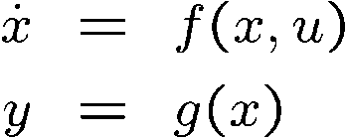
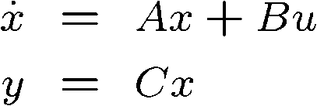
Classical vs “Modern” Control Design
Plant model:
Linearize:
Transfer function
Design estimator
Optimal: CDS 112
Robust: CDS 212
Design state fdbk
Design
Implement:

Slide 7
Course Overview
Given
J($x,u,t,T$)$=\int_{0}^{T}{l\left(x,u,t\right) dt +V\left(x\left(T\right),u\left(T\right)\right) }$
Optimization:
Optimal state feedback (linear sys. u = –Kx)
On-line implementation of optimal control (RHC)
Trajectory generation (calculus of variations)
Optimal estimation:
Optimization: minimize covariance of estimate error…
need to model stochastic processes
Robustness
How to quantify, analyze, and design for uncertainty
Formalizes classical control loop-shaping ideas
Connects time- and frequency-domain design
More focus on discrete-time control
$$\dot{x}=f(x,u,n)$$
Weeks 1 – 4
Given
$$\dot{x}=f(x,u,n)$$
y$=h\left(x\right)+ ω$
^
Weeks 5 – 9
Find best estimate of x: x
Week 10 ?
(CDS 212)

Slide 8
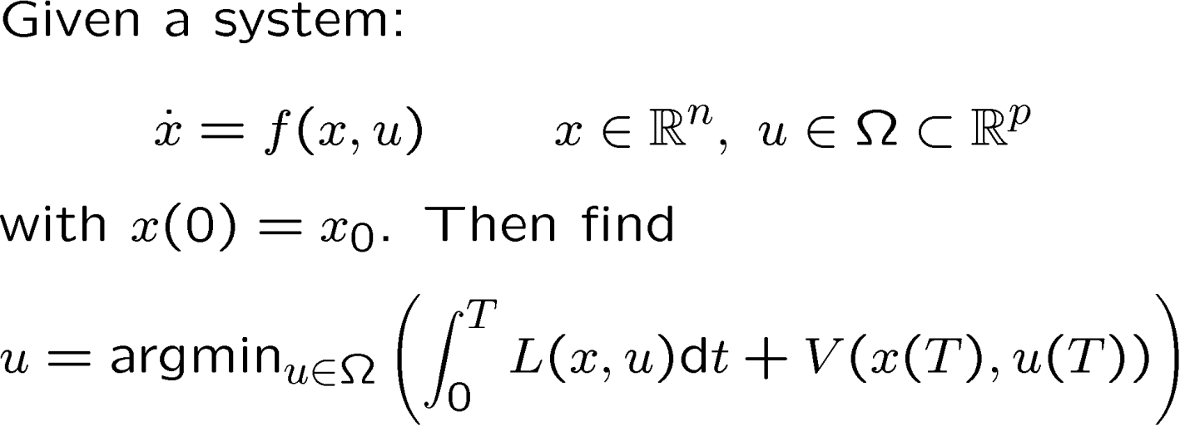
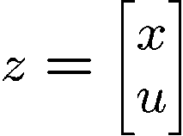
Optimal Control of Systems (Assignment: start Reading Chap. 2 of Optimal Control Notes)
Instantaneous, (Stage) Cost
Terminal Cost
Can include additional constraints on control u, and on state (along trajectory or at final time):
Final time T may or may not be free (we’ll first derive fixed T case)
Define , then this is a problem of minimizing J(z) subject to constraints G(z)=0
J(x,u)

Slide 9
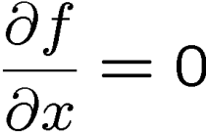
Function Optimization
Necessary condition for optimality is that gradient is zero
Characterizes local extrema; need to check sign of second derivative
Need convexity to guarantee global optimum
Keep this analogy in mind:
at an extremum
$$\lim_{∆x→0}\left\{f\left(x^{∗}+∆x\right)−f(x^{∗})\right\}=0$$
Gradient of f(x) orthogonal to level sets
$$\lim_{∆x→0}\left\{f\left(x^{∗}\right)+\frac{∂f(x^{∗})}{∂x}∆x+ …. −f(x^{∗})\right\}=0$$
Level sets of f(x)

Slide 10
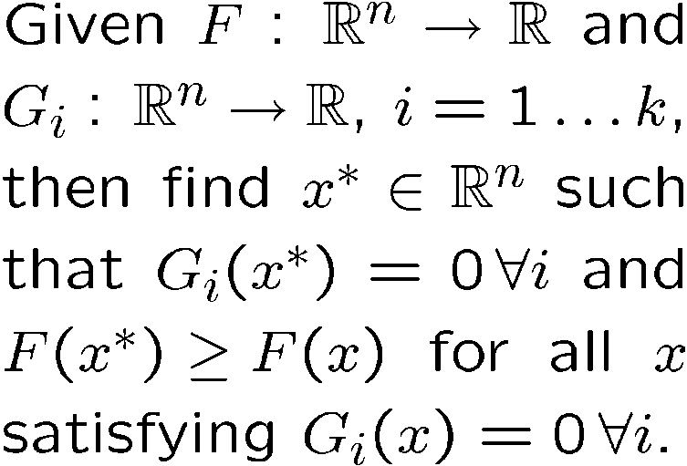
Constrained Function optimization
Then at optimal solution, gradient of F(x) must be parallel to gradient of G(x):
More generally, define:
Then a necessary condition is:
The Lagrange multipliers λ are the sensitivity of the cost to a change in G
Lagrange multiplier
Constraint G(x)=0
x*
Level sets of F(x)

Slide 11
Optimal Control of Systems
Easy to include additional constraints on control u, and on state (along trajectory or at final time)
Final time T may or may not be free (I’ll only derive for fixed T)
Define , then this is a problem of minimizing J(z) subject to constraints G(z)=0
J(x,u)

Slide 12
Solution approach
Add Lagrange multiplier λ(t) for dynamic constraint
And additional multipliers for terminal constraints or state constraints
Form augmented cost functional:
where the Hamiltonian is:
Necessary condition for optimality: vanishes for any perturbation (variation) in x, u, or λ about optimum:
“variations”
x(t) = x*(t) + δx(t); u(t) = u*(t) + δu(t); λ(t) = λ*(t) + δλ (t);
Variations must satisfy path end conditions!

Slide 13
variation
δc(t’)
δc(t)={δx(t), δu(t), δλ(t)}
x_{T}=c(T)
c(t’)
={x(t),u(t),λ(t)}
x₀=c(0)

Slide 14
Derivation…
Note that (integration by parts):
So:
We want this to be stationary for all variations

Slide 15
Pontryagin’s Maximum Principle
Optimal (x*,u*) satisfy:
Can be more general and include terminal constraints
Follows directly from:
Optimal control is solution to O.D.E.
0
0
0
0

Slide 16
Interpretation of λ
Two-point boundary value problem: λ is solved backwards in time
λ is the “co-state” (or “adjoint” variable)
Recall that H = L(x,u) + λ^{T}f(x,u)
If L=0, λ(t) is the sensitivity of the cost to a perturbation in state x(t)
In the integral as
Recall δJ = … +λ(0)δx(0)

