Slide 1
Optimal Control of Systems
Given a system: ; ; ; x(0) = x₀
$$\dot{x}=f(x,u,n)$$
Find the control u(t) for t ε [0,T] such that
Instantaneous (Stage) Cost
Terminal Cost
$$u=\underset{uε\text{Ω}}{arg lim}{\int_{0}^{T}{L\left(x,u\right)dt + V\left(x\left(T\right),u\left(T\right)\right)}}$$
$$J(x,u)$$
Can include constraints on control u and state x
(along trajectory or at final time):
Final time T may or may not be free (we’ll first derive fixed T case)

Slide 2
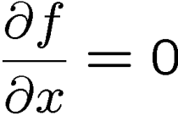
Function Optimization
Necessary condition for optimality is that gradient is zero
Characterizes local extrema; need to check sign of second derivative
Need convexity to guarantee global optimum
Keep this analogy in mind:
at an extremum
$$\lim_{∆x→0}\left\{f\left(x^{∗}+∆x\right)−f(x^{∗})\right\}=0$$
Gradient of f(x) orthogonal to level sets
$$\lim_{∆x→0}\left\{f\left(x^{∗}\right)+\frac{∂f(x^{∗})}{∂x}∆x+ … −f(x^{∗})\right\}=0$$

Slide 3
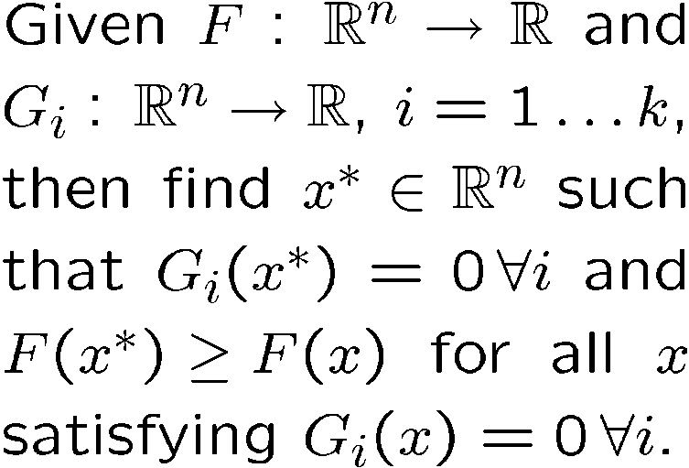
Constrained Function optimization
At the optimal solution, gradient of F(x) must be parallel to gradient of G(x):
Consider:
Constraint G(x)=0
Constraint G(x)=0
x*
Level sets of F(x)
Level sets of F(x)

Slide 4
Constrained Function optimization
At the optimal solution, gradient of F(x) must be parallel to gradient of G(x):
More generally, define:
Then a necessary condition is:
The Lagrange multipliers λ are the sensitivity of the cost to a change in G
Lagrange multiplier
Constraint G(x)=0
x*
Level sets of F(x)

Slide 5
Solution approach
Add Lagrange multiplier λ(t) for dynamic constraint
And additional multipliers for terminal constraints or state constraints
Form augmented cost functional:
where the Hamiltonian is:
Necessary condition for optimality: vanishes for any perturbation (variation) in x, u, or λ about optimum:
“variations”
x(t) = x*(t) + δx(t); u(t) = u*(t) + δu(t); λ(t) = λ*(t) + δλ (t);
Variations must satisfy path end conditions!

Slide 6
variation
δc(t’)
δc(t)={δx(t), δu(t), δλ(t)}
x_{T}=c(T)
c(t’)
={x(t),u(t),λ(t)}
x₀=c(0)

Slide 7
Derivation…
Note that (integration by parts):
So:
We want this to be stationary for all variations

Slide 8
Pontryagin’s Maximum Principle
Optimal (x*,u*) satisfy:
Can be more general and include terminal constraints
Follows directly from:
Optimal control is solution to O.D.E.
Unbounded controls
0
0
0
0

Slide 9
Interpretation of λ
Two-point boundary value problem: λ is solved backwards in time
λ is the “co-state” (or “adjoint” variable)
Recall that H = L(x,u) + λ^{T}f(x,u)
If L=0, λ(t) is the sensitivity of the cost to a perturbation in state x(t)
In the integral as
Recall δJ = … +λ(0)δx(0)

Slide 10
General Nonlinear Optimization
For a control input u^{k}(t), compute the sensitivity:
Given λ(t), note gradient of cost is
Linear problem, quadratic cost, can take one step to the minimum
In nonlinear problem, take step in gradient direction
Do line-search along gradient direction, since forward iterations are typically cheap compared to adjoint
With new guess for control input u^{k+1}(t), iterate… until converged
(to a local minimum)
x(T)
x(0)
λ(t)
Compute λ(T) from x(T)
Linearize about forward trajectory

Slide 11
Terminal Constraints
Assume q terminal constraints of the form: ψ(x(T))=0
Then
λ(T) = $\left(\frac{∂V}{∂x}\right)\left(x\left(T\right)\right)+\left(\frac{∂ψ}{∂x}\right)$(x(T)) $v^{}$
Where ν is a set of undetermined Lagrange Multipliers
Under some conditions, ν is free, and therefore λ(T) is free as well
When the final time T is free (i.e., it is not predetermined), then the cost function J must be stationary with respect to perturbations T: T* + δT. In this case:
H(T) = 0

Slide 12
General Remarks

Slide 13
Example: Bang-Bang Control
“minimum time control”
H
λ^{T} B>0
-1
+1
u
Since H is linear w.r.t. u, minimization occurs at boundary

Slide 14
Linear system, Quadratic cost
Apply PMP:
Guess that λ(t)=P(t)x(t):
x^{T}Px has an interpretation as the “cost to go”
Often see the infinite-horizon solution where dP/dt=0
B^{T} selects the part of the state that is influenced by u, so B^{T}λ is sensitivity of aug. state cost to u

