Slide 1
Analysis of Basic PMP Solution
Find control u(t) which minimizes the function:
$$J\left(x,u\right)={\int_{0}^{T}{L\left(x,u\right)dt + V\left(x\left(T\right)\right)}}$$
x(t=0) = x_{0,} T fixed,
$$\dot{x}=f(x,u)$$
To find a necessary condition to minimize J(x,u), we augment the cost function with the dynamics constraints
$\tilde{J}\left(x,u,λ\right)= J\left(x,u\right)+{\int_{0}^{T}{λ^{T}(f\left(x,u\right)−\dot{x})dt }}=\int_{0}^{T}{\left({H\left(x,u\right)−λ}^{T}\dot{x}\right) dt +V(x\left(T\right))}$
Extremize the augmented cost w.r.t. variations
δx(t); δu(t); δλ (t);
0
0
0
$$δ\tilde{J}=\int_{0}^{T}{\left[\left({\frac{∂H}{∂x}+λ}^{T}\dot{x}\right)δx +\frac{∂H}{∂u}δu+\left({\frac{∂H}{∂λ}−\dot{x}}^{T}\right)δλ\right]}dt$$
$+ \left(\frac{∂V}{∂x}−λ^{T}\left(T\right)\right)δx\left(T\right)+λ^{T}\left(0\right)$ $δx\left(0\right)$
$${H\left(x,u\right)≡L\left(x,u\right)+λ}^{T}f(x,u)$$
0
0

Slide 2
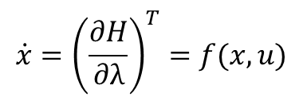
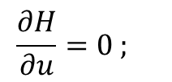
Dimension of PMP Solution
Unknowns
n state variables x(t)
n co-state variables 𝜆(t)
m control variables u(t)
Optimal control satisfies:
$$\dot{x}={\left(\frac{∂H}{∂λ}\right)}^{T}=f(x,u)$$
$$x\left(0\right)=x_{0}$$
n o.d.e.s with I.C.s
2 point
B.V. problem
$$\dot{−λ}={\left(\frac{∂H}{∂x}\right)}^{T}$$
λ$\left(T\right)=\frac{∂V}{∂x}\left(x\left(T\right)\right)$
n o.d.e.s with T.C.s
$$\frac{∂H}{∂u}=0 ;$$
m algebraic equations

Slide 3
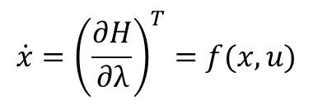
Additional Constraints?
Example: what if final state constraints φ_{i}(x(T))=0, i=1,…,p are desired:
Add constraints to cost using additional Lagrange multipliers
Multipliers
$$Ja\left(x,u\right)={\int_{0}^{T}{L\left(x,u\right)dt + V\left(x\left(T\right)\right)}+ {v_{1}φ}_{1}\left(x\left(T\right)\right)+ …+v_{p}φ_{p}\left(x\left(T\right)\right)}$$
Cost augmentation
Extremizing the constrained, augmented the cost function yields
$$\dot{x}={\left(\frac{∂H}{∂λ}\right)}^{T}=f(x,u)$$
$$x\left(0\right)=x_{0}$$
n o.d.e.s with I.C.s
$$\dot{−λ}={\left(\frac{∂H}{∂x}\right)}^{T}$$
λ$\left(T\right)=\frac{∂V}{∂x}(x\left(T\right))+ \frac{∂φ}{∂x}(x\left(T\right))\vec{v}$
n o.d.e.s with T.C.s
$$\frac{∂H}{∂u}=0 ;$$
m algebraic equations
$$φ_{1}\left(x\left(T\right)\right)=0; …; φ_{p}\left(x\left(T\right)\right)=0$$
p algebraic equations

Slide 4
Additional Constraints?
Example: what if final time is undetermined?
Final time T is an additional variable
H(T) = 0 gives one additional constraint equation!

