Slide 1
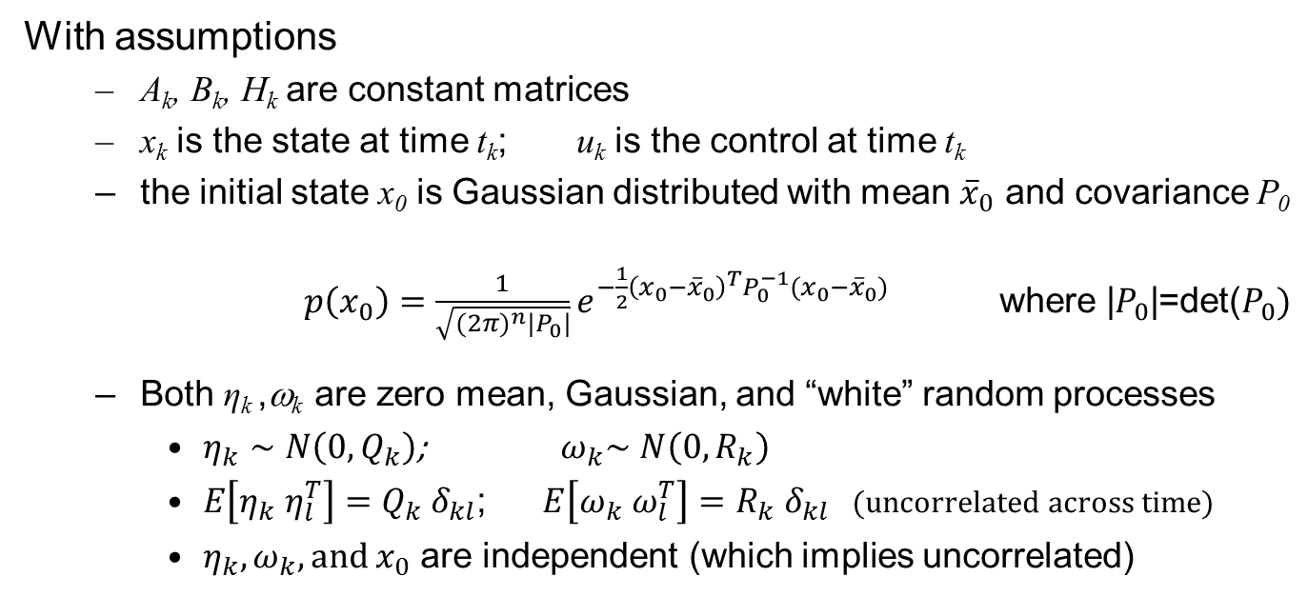
Estimation: Recap
Given the discrete time system
$$x_{k+1}=A_{k}x_{k}+B_{k}u_{k}+G_{k} η_{k};$$
$$y_{k}=H_{k}x_{k}+ω_{k};$$
With assumptions
  A_{k}, B_{k}, H_{k} are constant matrices
  x_{k} is the state at time t_{k}; u_{k} is the control at time t_{k}
  the initial state x₀ is Gaussian distributed with mean ${\overline{x}}_{0}$ and covariance P₀
  $p\left(x_{0}\right)=\frac{1}{\sqrt{{(2π)}^{n}|P_{0}|}}e^{{−\frac{1}{2}\left(x_{0}−{\overline{x}}_{0}\right)}^{T}P_{0}^{−1}(x_{0}−{\overline{x}}_{0})}$ where |$P_{0}$|=det($P_{0})$
  Both η_{k} ,ω_{k} are zero mean, Gaussian, and “white” random processes
    $η_{k}∼N\left(0,Q_{k}\right)$; ${ ω}_{k}∼N\left(0,R_{k}\right)$
    $E\left[η_{k}{ η}_{l}^{T}\right]=Q_{k}{ δ}_{kl}$; $E\left[ω_{k}{ ω}_{l}^{T}\right]=R_{k}{ δ}_{kl}$ (uncorrelated across time)
    $η_{k}, ω_{k}, and x_{0}$ are independent (which implies uncorrelated)
Find state estimate which minimizes a loss function:

Slide 2
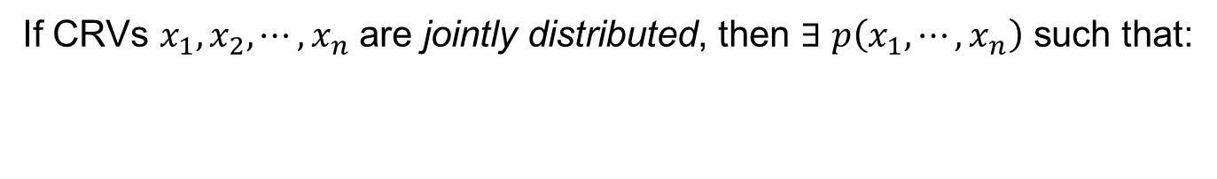
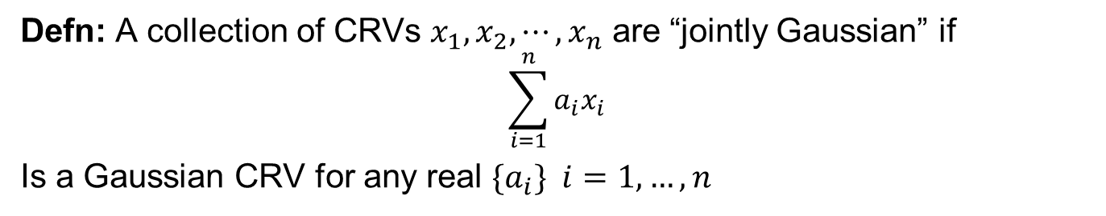
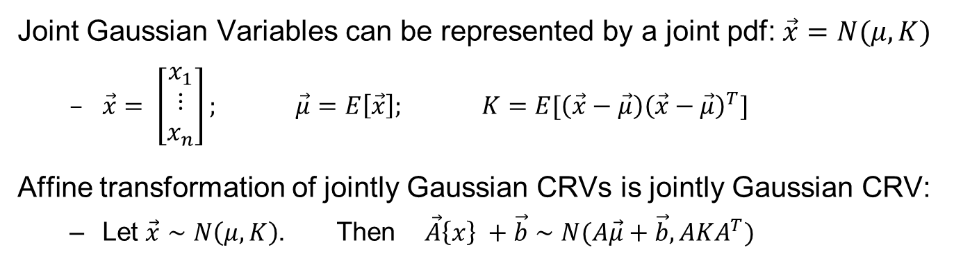
Jointly Gaussian Random Variables
If CRVs $x_{1},x_{2},⋯, x_{n}$ are jointly distributed, then $∃$ $p\left(x_{1}, ⋯, x_{n}\right)$ such that:
$$P\left(x_{1l}≤x_{1}≤ x_{1u}; {⋯;x}_{nl}≤x_{n} ≤ x_{nu}\right)≡\int_{x_{1l}}^{x_{1u}}{⋯\int_{x_{nl}}^{x_{nu}}{p\left(x_{1},{…, x}_{n}\right)dx_{1}⋯}dx_{n}}$$
Defn: A collection of CRVs $x_{1},x_{2},⋯, x_{n}$ are “jointly Gaussian” if
$$\sum_{i=1}^{n}{a_{i}x_{i}}$$
Is a Gaussian CRV for any real $\{a_{i}\} i=1,…, n$
Joint Gaussian Variables can be represented by a joint pdf: $\vec{x}=N(μ,K)$
  $\vec{x}= \left[\begin{matrix}x_{1} \\ ⋮ \\ x_{n}\end{matrix}\right]; \vec{μ}=E\left[\vec{x}\right];$ $K=E[\left(\vec{x}−\vec{μ}\right){\left(\vec{x}−\vec{μ}\right)}^{T}]$
Affine transformation of jointly Gaussian CRVs is jointly Gaussian CRV:
  Let $\vec{x}∼N\left(μ,K\right)$. Then $\vec{A}\left\{x\right\} +\vec{b}∼N(A\vec{μ}+\vec{b}, AKA^{T})$

Slide 3
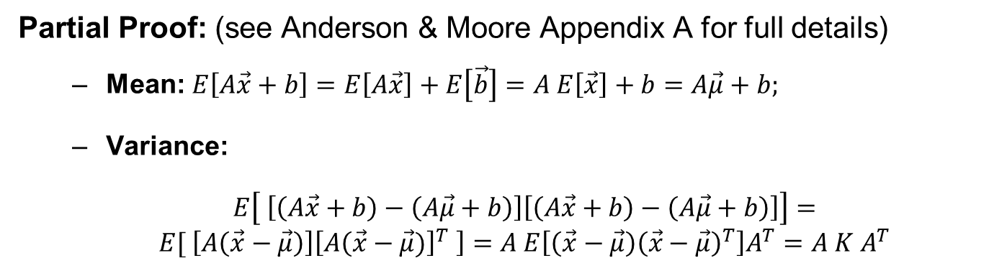
Jointly Gaussian Random Variables
Partial Proof: (see Anderson & Moore Appendix A for full details)
  Mean: $E\left[A\vec{x}+b\right]=E\left[A\vec{x}\right]+E\left[\vec{b}\right]=A E\left[\vec{x}\right]+b=A\vec{μ}+b;$
  Variance:
  $E\left[ \left[\left(A\vec{x}+b\right)−\left(A\vec{μ}+b\right)\right]\left[\left(A\vec{x}+b\right)−\left(A\vec{μ}+b\right)\right]\right]=E[ \left[A\left(\vec{x}−\vec{μ}\right)\right]\left[A{\left(\vec{x}−\vec{μ})\right]}^{T} \right]=A E\left[\left(\vec{x}−\vec{μ}\right){\left(\vec{x}−\vec{μ}\right)}^{T}\right]A^{T}=A K A^{T}$
Fact: Jointly Gaussian RVs are independent iff they are uncorrelated

Slide 4
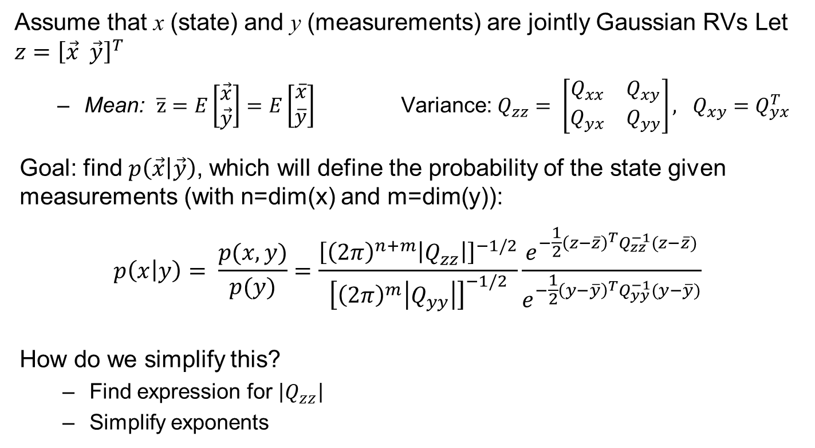
Conditional Density of Jointly Gaussian RVs
Assume that x (state) and y (measurements) are jointly Gaussian RVs Let $z={\left[\vec{x} \vec{y}\right]}^{T}$
  Mean: $\overline{z}=E\left[\begin{matrix}\vec{x} \\ \vec{y}\end{matrix}\right]=E\left[\begin{matrix}\overline{x} \\ \overline{y}\end{matrix}\right]$Variance: $Q_{zz}= \left[\begin{matrix}Q_{xx} & Q_{xy} \\ Q_{yx} & Q_{yy}\end{matrix}\right], Q_{xy}=Q_{yx}^{T}$
Goal: find $p\left(\vec{x} | \vec{y}\right)$, which will define the probability of the state given measurements (with n=dim(x) and m=dim(y)):
$$p\left(x | y\right)= \frac{p(x,y)}{p(y)}=\frac{{\left[{\left(2π\right)}^{n+m}\left|Q_{zz}\right|\right]}^{−1/2}}{{\left[{\left(2π\right)}^{m}\left|Q_{yy}\right|\right]}^{−1/2}}\frac{e^{−{\frac{1}{2}\left(z−\overline{z}\right)}^{T}Q_{zz}^{−1}(z−\overline{z})}}{e^{−{\frac{1}{2}\left(y−\overline{y}\right)}^{T}Q_{yy}^{−1}(y−\overline{y})}}$$
How do we simplify this?
  Find expression for $\left|Q_{zz}\right|$
  Simplify exponents

Slide 5
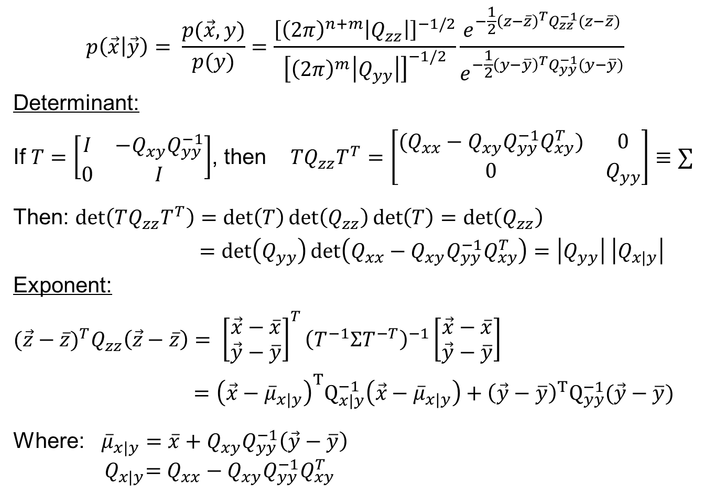
Conditional Density (continued)
$$p\left(\vec{x} | \vec{y}\right)= \frac{p(\vec{x},y)}{p(y)}=\frac{{\left[{\left(2π\right)}^{n+m}\left|Q_{zz}\right|\right]}^{−1/2}}{{\left[{\left(2π\right)}^{m}\left|Q_{yy}\right|\right]}^{−1/2}}\frac{e^{−{\frac{1}{2}\left(z−\overline{z}\right)}^{T}Q_{zz}^{−1}(z−\overline{z})}}{e^{−{\frac{1}{2}\left(y−\overline{y}\right)}^{T}Q_{yy}^{−1}(y−\overline{y})}}$$
Determinant:
If $T=\left[\begin{matrix}I & −Q_{xy}Q_{yy}^{−1} \\ 0 & I\end{matrix}\right]$, then $TQ_{zz}T^{T}=\left[\begin{matrix}(Q_{xx}−Q_{xy}Q_{yy}^{−1}Q_{xy}^{T}) & 0 \\ 0 & Q_{yy}\end{matrix}\right]≡∑$
Then: $\det\left(TQ_{zz}T^{T}\right)=\det\left(T\right)\det\left(Q_{zz}\right)\det\left(T\right)=\det\left(Q_{zz}\right)$
$=\det\left(Q_{yy}\right)\det\left(Q_{xx}−Q_{xy}Q_{yy}^{−1}Q_{xy}^{T}\right)=\left|Q_{yy}\right| \left|Q_{x|y}\right|$
Exponent:
$(\vec{z}−{\overline{z})}^{T}Q_{zz}\left(\vec{z}−\overline{z}\right)= {\left[\begin{matrix}\vec{x}−\overline{x} \\ \vec{y}−\overline{y}\end{matrix}\right]}^{T}{\left(T^{−1}ΣT^{−T}\right)}^{−1}\left[\begin{matrix}\vec{x}−\overline{x} \\ \vec{y}−\overline{y}\end{matrix}\right]$
$={{\left(\vec{x}−{\overline{μ}}_{x|y}\right)}^{T}Q}_{x|y}^{−1}\left(\vec{x}−{\overline{μ}}_{x|y}\right)+{{\left(\vec{y}−\overline{y}\right)}^{T}Q}_{yy}^{−1}(\vec{y}−\overline{y})$
Where: ${\overline{μ}}_{x|y}=\overline{x}+Q_{xy}Q_{yy}^{−1}\left(\vec{y}−\overline{y}\right)$
$${ Q}_{x|y}=Q_{xx}−Q_{xy}Q_{yy}^{−1}Q_{xy}^{T}$$

Slide 6
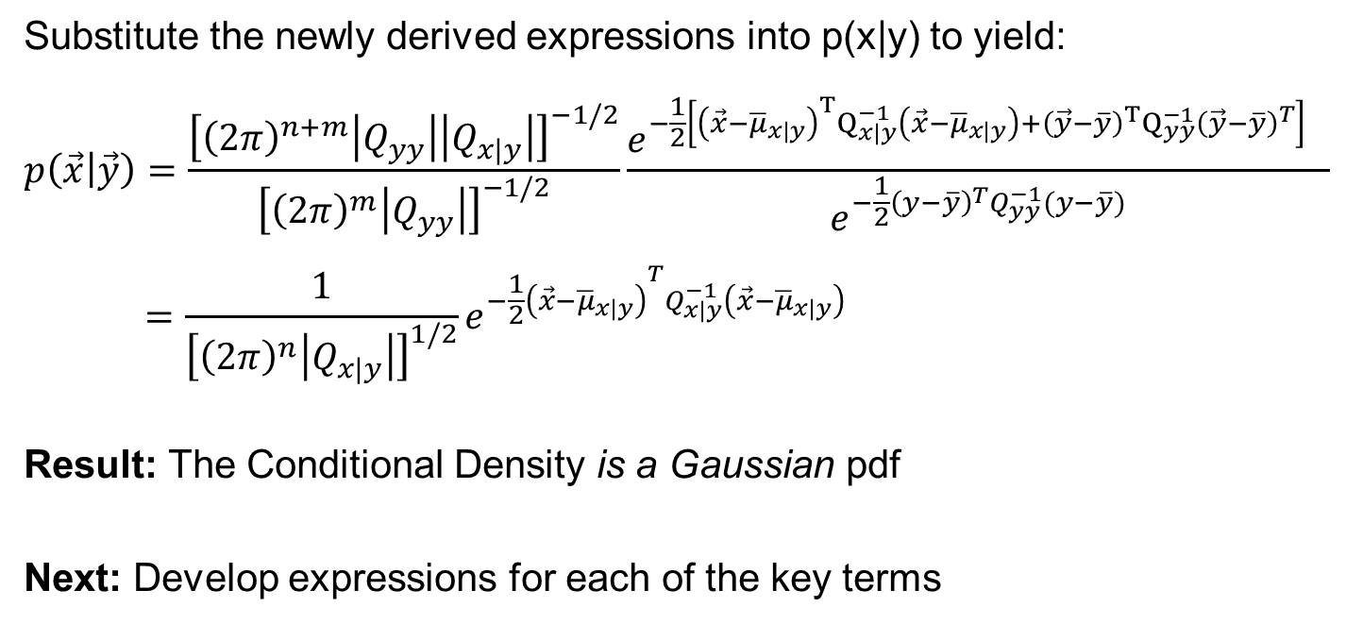
Conditional Density (continued)
Substitute the newly derived expressions into p(x|y) to yield:
$$p\left(\vec{x} | \vec{y}\right)=\frac{{\left[{\left(2π\right)}^{n+m}\left|Q_{yy}\right|\left|Q_{x|y}\right|\right]}^{−1/2}}{{\left[{\left(2π\right)}^{m}\left|Q_{yy}\right|\right]}^{−1/2}}\frac{e^{−{\frac{1}{2}\left[{{\left(\vec{x}−{\overline{μ}}_{x|y}\right)}^{T}Q}_{x|y}^{−1}\left(\vec{x}−{\overline{μ}}_{x|y}\right)+{{\left(\vec{y}−\overline{y}\right)}^{T}Q}_{yy}^{−1}{\left(\vec{y}−\overline{y}\right)}^{T}\right]}^{}}}{e^{−{\frac{1}{2}\left(y−\overline{y}\right)}^{T}Q_{yy}^{−1}(y−\overline{y})}}$$
$$=\frac{1}{{\left[{\left(2π\right)}^{n}\left|Q_{x|y}\right|\right]}^{1/2}}e^{−{\frac{1}{2}\left(\vec{x}−{\overline{μ}}_{x|y}\right)}^{T}Q_{x|y}^{−1}\left(\vec{x}−{\overline{μ}}_{x|y}\right)}$$
Result: The Conditional Density is a Gaussian pdf
Next: Develop expressions for each of the key terms

Slide 7
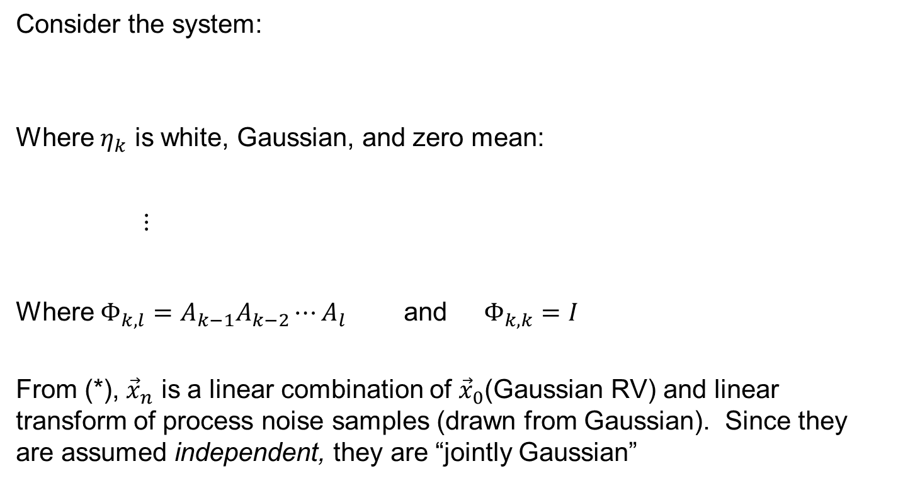
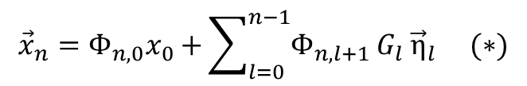
Linear Discrete Time Systems
Consider the system:
Where $η_{k}$ is white, Gaussian, and zero mean:
$$⋮$$
Where $Φ_{k,l}=A_{k−1}A_{k−2}⋯A_{l}$ and $Φ_{k,k}=I$
From (*), ${\vec{x}}_{n}$ is a linear combination of ${\vec{x}}_{0}$(Gaussian RV) and linear transform of process noise samples (drawn from Gaussian). Since they are assumed independent, they are “jointly Gaussian”
Add constant term later
$${\vec{x}}_{k+1}=A_{k}{\vec{x}}_{k}+B_{k}{\vec{u}}_{k}+G_{k} {\vec{η}}_{k} = A_{k}{\vec{x}}_{k}+G_{k} {\vec{η}}_{k};$$
$${\vec{x}}_{k+2}=A_{k+1}{\vec{x}}_{k+1}{+ G}_{k+1} {\vec{η}}_{k+1} = {A_{k+1}A}_{k}{\vec{x}}_{k}+{A_{k+1}G}_{k} {\vec{η}}_{k}+G_{k+1} {\vec{η}}_{k+1};$$
$${\vec{x}}_{n}=Φ_{n,0}x_{0}{+\sum_{l=0}^{n−1}{Φ_{n,l+1}}G}_{l}{\vec{η}}_{l} (∗)$$

Slide 8
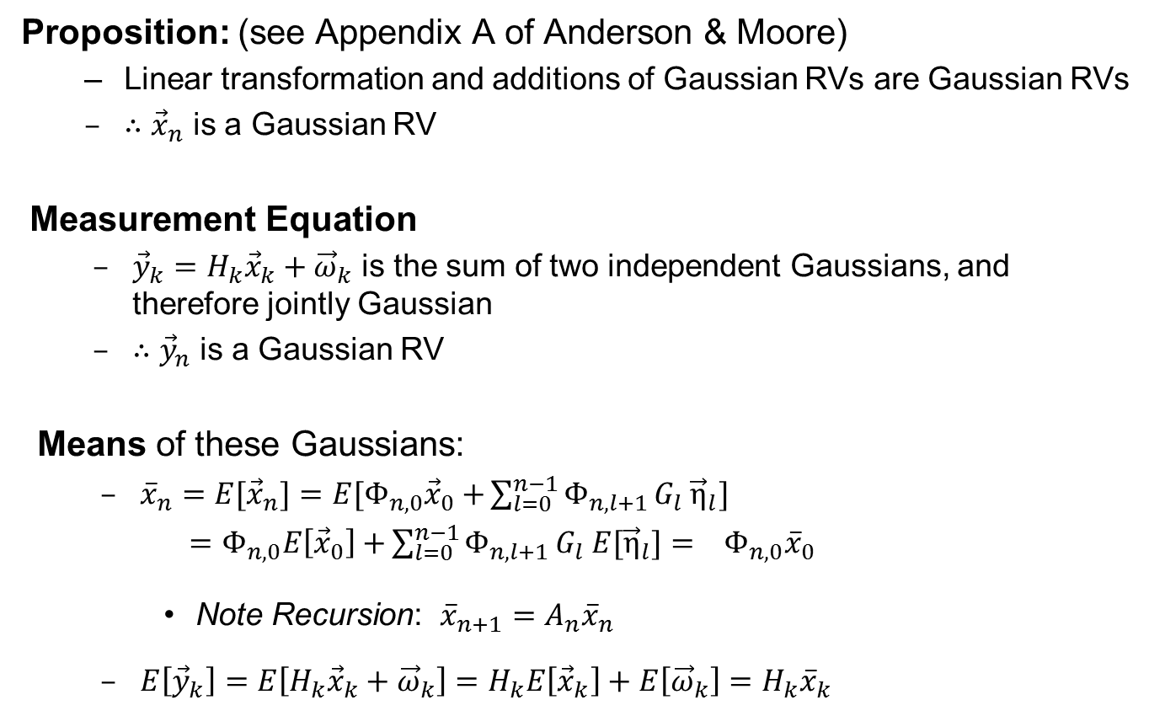
Linear Discrete Time Systems
Proposition: (see Appendix A of Anderson & Moore)
  Linear transformation and additions of Gaussian RVs are Gaussian RVs
  $∴$ ${\vec{x}}_{n}$ is a Gaussian RV
Measurement Equation
  ${\vec{y}}_{k}=H_{k}{\vec{x}}_{k}+{\vec{ω}}_{k}$ is the sum of two independent Gaussians, and therefore jointly Gaussian
  $∴{\vec{y}}_{n}$ is a Gaussian RV
Means of these Gaussians:
  ${\overline{x}}_{n}={E[\vec{x}}_{n}]=E{[Φ}_{n,0}{\vec{x}}_{0}{+\sum_{l=0}^{n−1}{Φ_{n,l+1}}G}_{l}{\vec{η}}_{l}]$
  $=Φ_{n,0}E\left[{\vec{x}}_{0}\right]{+\sum_{l=0}^{n−1}{Φ_{n,l+1}}G}_{l}{E[\vec{η}}_{l}]= Φ_{n,0}{\overline{x}}_{0}$
    Note Recursion: ${\overline{x}}_{n+1}=A_{n}{\overline{x}}_{n}$
  $E\left[{\vec{y}}_{k}\right]=E\left[H_{k}{\vec{x}}_{k}+{\vec{ω}}_{k}\right]=H_{k}E\left[{\vec{x}}_{k}\right]+E\left[{\vec{ω}}_{k}\right]=H_{k}{\overline{x}}_{k}$

Slide 9
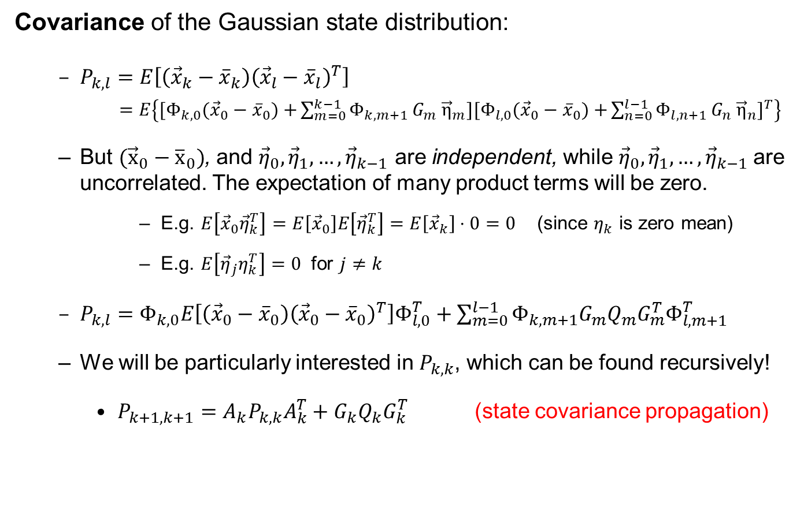
Linear Discrete Time Systems
Covariance of the Gaussian state distribution:
  $P_{k,l}=E\left[\left({\vec{x}}_{k}−{\overline{x}}_{k}\right){\left({\vec{x}}_{l}−{\overline{x}}_{l}\right)}^{T}\right]$
  $=E\left\{{[Φ}_{k,0}({\vec{x}}_{0}−{\overline{x}}_{0}){+\sum_{m=0}^{k−1}{Φ_{k,m+1}}G}_{m}{\vec{η}}_{m}]{{[Φ}_{l,0}({\vec{x}}_{0}−{\overline{x}}_{0}){+\sum_{n=0}^{l−1}{Φ_{l,n+1}}G}_{n}{\vec{η}}_{n}]}^{T}\right\}$
  But $({\vec{x}}_{0}−{\overline{x}}_{0})$, and ${\vec{η}}_{0},{\vec{η}}_{1},…, {\vec{η}}_{k−1}$ are independent, while ${\vec{η}}_{0},{\vec{η}}_{1},…, {\vec{η}}_{k−1}$are uncorrelated. The expectation of many product terms will be zero.
      E.g. $E\left[{\vec{x}}_{0}{\vec{η}}_{k}^{T}\right]=E\left[{\vec{x}}_{0}\right]E\left[{\vec{η}}_{k}^{T}\right]=E\left[{\vec{x}}_{k}\right]⋅0=0$ (since $η_{k}$ is zero mean)
      E.g. $E\left[{\vec{η}}_{j}η_{k}^{T}\right]=0$ for $j≠k$
  $P_{k,l}=Φ_{k,0}E\left[\left({\vec{x}}_{0}−{\overline{x}}_{0}\right){\left({\vec{x}}_{0}−{\overline{x}}_{0}\right)}^{T}\right]Φ_{l,0}^{T}+\sum_{m=0}^{l−1}{Φ_{k,m+1}G_{m}Q_{m}G_{m}^{T}Φ_{l,m+1}^{T}}$
  We will be particularly interested in $P_{k,k}$, which can be found recursively!
    $P_{k+1,k+1}=A_{k}P_{k,k}A_{k}^{T}+G_{k}Q_{k}G_{k}^{T}$ (state covariance propagation)
Dynamic
covariance propagation
Effect of Process Noise

Slide 10
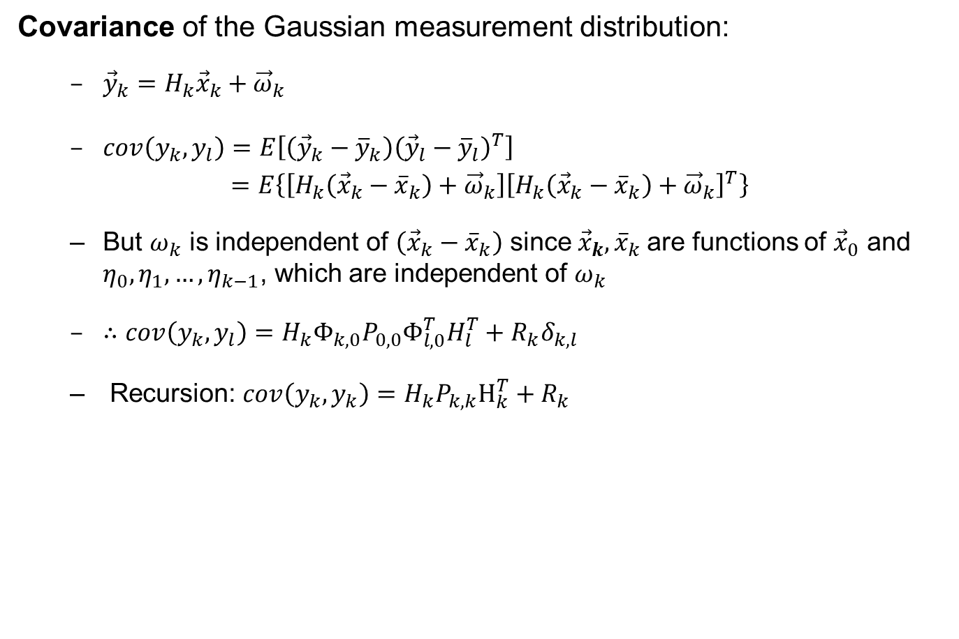
Linear Discrete Time Systems
Covariance of the Gaussian measurement distribution:
  ${\vec{y}}_{k}=H_{k}{\vec{x}}_{k}+{\vec{ω}}_{k}$
  $cov\left(y_{k},y_{l}\right)=E\left[\left({\vec{y}}_{k}−{\overline{y}}_{k}\right){\left({\vec{y}}_{l}−{\overline{y}}_{l}\right)}^{T}\right]$
  $=E\left\{\left[H_{k}\left({\vec{x}}_{k}−{\overline{x}}_{k}\right)+{\vec{ω}}_{k}\right]{\left[H_{k}\left({\vec{x}}_{k}−{\overline{x}}_{k}\right)+{\vec{ω}}_{k}\right]}^{T}\right\}$
  But $ω_{k}$ is independent of $\left({\vec{x}}_{k}−{\overline{x}}_{k}\right)$ since ${\vec{x}}_{k}, {\overline{x}}_{k}$are functions of ${\vec{x}}_{0}$ and $η_{0},η_{1},…, η_{k−1}$, which are independent of $ω_{k}$
  $∴$ $cov\left(y_{k},y_{l}\right)=H_{k}Φ_{k,0}P_{0,0}Φ_{l,0}^{T}H_{l}^{T}+R_{k}δ_{k,l}$
  Recursion: $cov\left(y_{k},y_{k}\right)=H_{k}P_{k,k}H_{k}^{T}+R_{k}$
Effect of state uncertainty on measurement uncertainty
Effect of measurement noise

