Slide 1
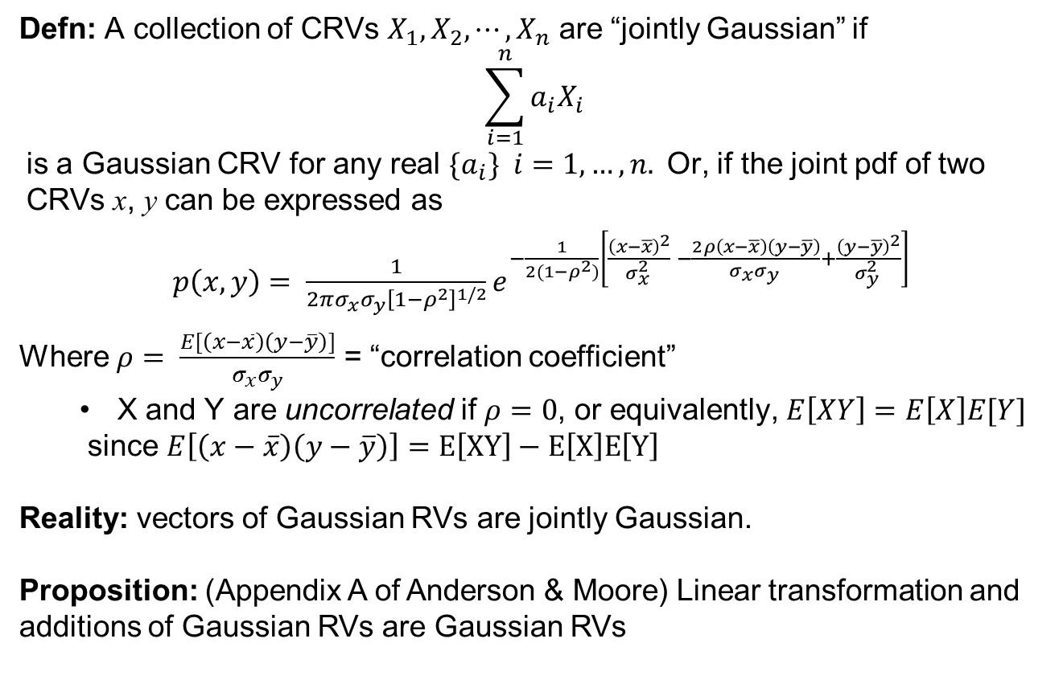
Recap
Defn: A collection of CRVs $X_{1},X_{2},⋯, X_{n}$ are “jointly Gaussian” if
$$\sum_{i=1}^{n}{a_{i}X_{i}}$$
is a Gaussian CRV for any real $\{a_{i}\} i=1,…, n.$Or, if the joint pdf of two CRVs x, y can be expressed as
$p\left(x,y\right)= \frac{1}{2π{σ_{x}σ_{y}\left[1−ρ^{2}\right]}^{1/2}}e^{−{\frac{1}{2(1−ρ^{2})}\left[\frac{{\left(x−\overline{x}\right)}^{2}}{σ_{x}^{2} } −\frac{2ρ\left(x−\overline{x}\right)\left(y−\overline{y}\right)}{σ_{x}σ_{y} }+\frac{{\left(y−\overline{y}\right)}^{2}}{σ_{y}^{2} }\right]}^{}}$
Where $ρ= \frac{E[\left(x−\overline{x}\right)\left(y−\overline{y}\right)]}{σ_{x}σ_{y}}$ = “correlation coefficient”
X and Y are uncorrelated if $ρ=0$, or equivalently, $E\left[XY\right]=E\left[X\right]E[Y]$
since $E\left[\left(x−\overline{x}\right)\left(y−\overline{y}\right)\right]=E\left[XY\right]−E\left[X\right]E\left[Y\right]$
Reality: vectors of Gaussian RVs are jointly Gaussian.
Proposition: (Appendix A of Anderson & Moore) Linear transformation and additions of Gaussian RVs are Gaussian RVs

Slide 2
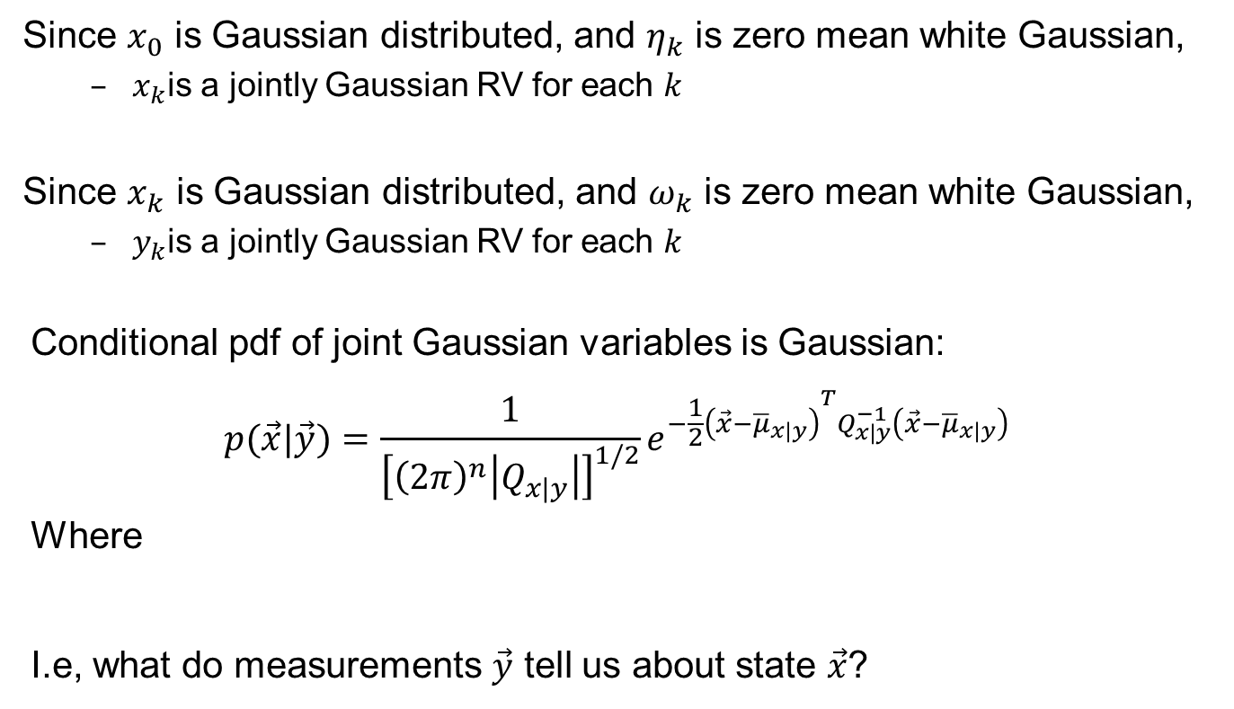
Recap
$$x_{k+1}=A_{k}x_{k}+B_{k}u_{k}+G_{k} η_{k};$$
$$y_{k}=H_{k}x_{k}+ω_{k};$$
Since $x_{0}$ is Gaussian distributed, and $η_{k}$ is zero mean white Gaussian,
$x_{k}$is a jointly Gaussian RV for each $k$
Since $x_{k}$ is Gaussian distributed, and $ω_{k}$ is zero mean white Gaussian,
$y_{k}$is a jointly Gaussian RV for each $k$
Conditional pdf of joint Gaussian variables is Gaussian:
$$p(\vec{x}|\vec{y})=\frac{1}{{\left[{\left(2π\right)}^{n}\left|Q_{x|y}\right|\right]}^{1/2}}e^{−{\frac{1}{2}\left(\vec{x}−{\overline{μ}}_{x|y}\right)}^{T}Q_{x|y}^{−1}\left(\vec{x}−{\overline{μ}}_{x|y}\right)}$$
Where
I.e, what do measurements $\vec{y}$ tell us about state $\vec{x}$?
$${\overline{μ}}_{x|y}=\overline{x}+Q_{xy}Q_{yy}^{−1}\left(\vec{y}−\overline{y}\right) { Q}_{x|y}=Q_{xx}−Q_{xy}Q_{yy}^{−1}Q_{xy}^{T}$$

Slide 3
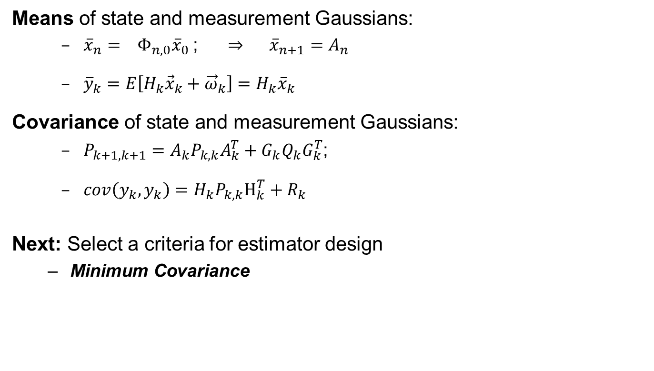
Linear Discrete Time Systems
Means of state and measurement Gaussians:
${\overline{x}}_{n}= Φ_{n,0}{\overline{x}}_{0}$; ⇒ ${\overline{x}}_{n+1}=A_{n}$
${\overline{y}}_{k}=E\left[H_{k}{\vec{x}}_{k}+{\vec{ω}}_{k}\right]=H_{k}{\overline{x}}_{k}$
Covariance of state and measurement Gaussians:
$P_{k+1,k+1}=A_{k}P_{k,k}A_{k}^{T}+G_{k}Q_{k}G_{k}^{T}$;
$cov\left(y_{k},y_{k}\right)=H_{k}P_{k,k}H_{k}^{T}+R_{k}$
Next: Select a criteria for estimator design
Minimum Covariance

Slide 4
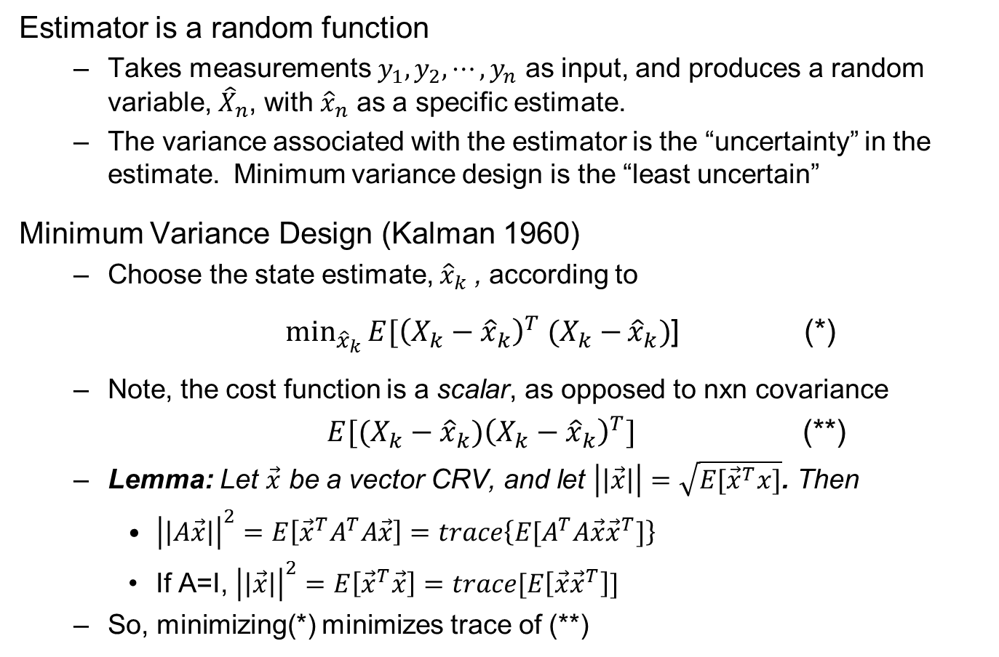
Minimum Variance Design
Estimator is a random function
Takes measurements $y_{1}, y_{2},⋯, y_{n}$ as input, and produces a random variable, ${\hat{X}}_{n}$, with ${\hat{x}}_{n}$ as a specific estimate.
The variance associated with the estimator is the “uncertainty” in the estimate. Minimum variance design is the “least uncertain”
Minimum Variance Design (Kalman 1960)
Choose the state estimate, ${\hat{x}}_{k}$ , according to
$\min_{{\hat{x}}_{k}}{E[{\left(X_{k}−{\hat{x}}_{k}\right)}^{T} (X_{k}−}{\hat{x}}_{k})$] (*)
Note, the cost function is a scalar, as opposed to nxn covariance
${E[(X_{k}−{\hat{x}}_{k})\left(X_{k}−{\hat{x}}_{k}\right)}^{T}]$ (**)
Lemma: Let $\vec{x}$ be a vector CRV, and let $\left|\left|\vec{x}\right|\right|=\sqrt{E[{\vec{x}}^{T}x]}$. Then
${\left|\left|A\vec{x}\right|\right|}^{2}=E\left[{\vec{x}}^{T}A^{T}A\vec{x}\right]=trace\left\{E[A^{T}A\vec{x}{\vec{x}}^{T}]\right\}$
If A=I, ${\left|\left|\vec{x}\right|\right|}^{2}=E\left[{\vec{x}}^{T}\vec{x}\right]=trace[E\left[\vec{x}{\vec{x}}^{T}\right]]$
So, minimizing(*) minimizes trace of (**)

Slide 5
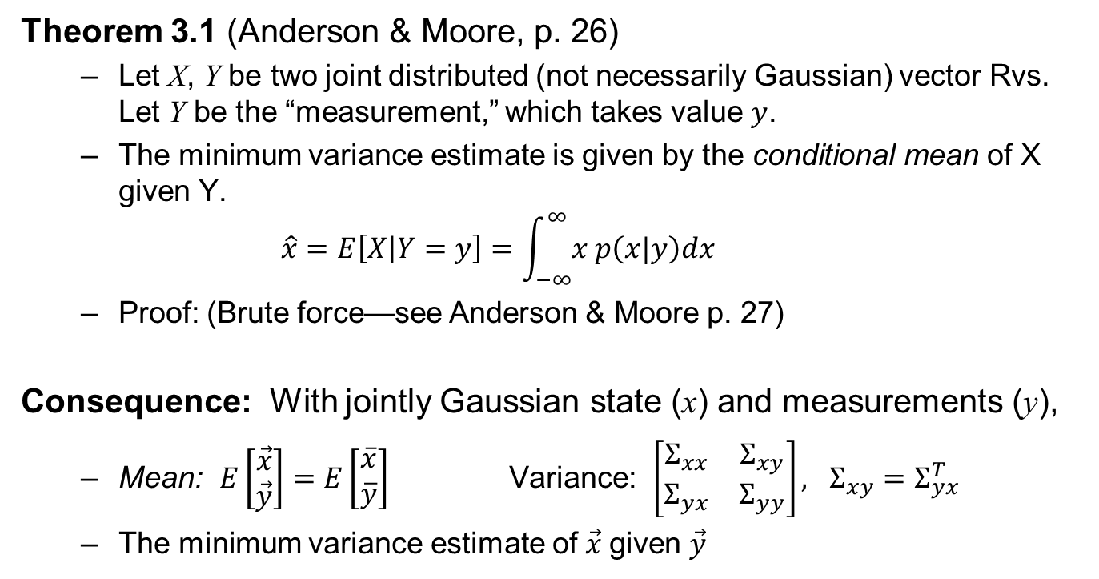
Minimum Variance Estimator
Theorem 3.1 (Anderson & Moore, p. 26)
Let X, Y be two joint distributed (not necessarily Gaussian) vector Rvs. Let Y be the “measurement,” which takes value $y$.
The minimum variance estimate is given by the conditional mean of X given Y.
$$\hat{x}=E\left[X | Y=y\right]=\int_{−∞}^{∞}{x p\left(x|y\right)dx}$$
Proof: (Brute force—see Anderson & Moore p. 27)
Consequence: With jointly Gaussian state (x) and measurements (y),
Mean: $E\left[\begin{matrix}\vec{x} \\ \vec{y}\end{matrix}\right]=E\left[\begin{matrix}\overline{x} \\ \overline{y}\end{matrix}\right]$Variance: $\left[\begin{matrix}Σ_{xx} & Σ_{xy} \\ Σ_{yx} & Σ_{yy}\end{matrix}\right], Σ_{xy}=Σ_{yx}^{T}$
The minimum variance estimate of $\vec{x}$given $\vec{y}$
$$\hat{x}=\overline{x}+Σ_{xy}Σ_{yy}^{−1}\left(\vec{y}−\overline{y}\right) { Σ}_{x|y}=Σ_{xx}−Σ_{xy}Σ_{yy}^{−1}Σ_{xy}^{T}$$

