Slide 1
Minimum Variance Design
Estimator is a random function
Takes measurements $y_{1}, y_{2},⋯, y_{n}$ as input, and produces a random variable, ${\hat{X}}_{n}$, with ${\hat{x}}_{n}$ as a specific estimate.
The variance associated with the estimator is the “uncertainty” in the estimate. Minimum variance design is the “least uncertain”
Minimum Variance Design (Kalman 1960)
The minimum variance estimate of state X given measurements Y is given by the conditional mean of X given Y.
$$\hat{x}=E\left[X | Y=y\right]=\int_{−∞}^{∞}{x p\left(x|y\right)dx}$$
With jointly Gaussian state (x) and measurements (y),
Mean: $E\left[\begin{matrix}\vec{x} \\ \vec{y}\end{matrix}\right]=E\left[\begin{matrix}\overline{x} \\ \overline{y}\end{matrix}\right]$Variance: $\left[\begin{matrix}Σ_{xx} & Σ_{xy} \\ Σ_{yx} & Σ_{yy}\end{matrix}\right], Σ_{xy}=Σ_{yx}^{T}$
The minimum variance estimate of $\vec{x}$given $\vec{y}$
$$\hat{x}=\overline{x}+Σ_{xy}Σ_{yy}^{−1}\left(\vec{y}−\overline{y}\right) { Σ}_{x|y}=Σ_{xx}−Σ_{xy}Σ_{yy}^{−1}Σ_{xy}^{T}$$

Slide 2
Recursive Construction of Kalman Filter (KF)
Initial system state, $x_{0}$, is Gaussian distributed: $x_{0}∼N({\overline{x}}_{0},P_{00})$
Assume measurement $y_{0}=H_{0}x_{0}+ω_{0}$. Then $x_{0}, y_{0}$ are joint Gaussian:
$$\left[\begin{matrix}x_{0} \\ y_{0}\end{matrix}\right]∼N\left(\left[\begin{matrix}{\overline{x}}_{0} \\ H_{o}{\overline{x}}_{0}\end{matrix}\right],\left[\begin{matrix}P_{00} & P_{00}H_{0}^{T} \\ H_{0}P_{00} & H_{0}^{}P_{00}H_{0}^{T}+R_{0}\end{matrix}\right]\right)$$
The estimate of state $x_{0}$ at time $t_{0}$ given measurements at $t_{0}$ is
${\hat{x}}_{0|0}={\overline{x}}_{0}+P_{00}H_{0}^{T}{\left(H_{0}^{}P_{00}H_{0}^{T}+R_{0}\right)}^{−1}(y_{0}−H_{o}{\overline{x}}_{0})$
Because the estimate is a conditional mean, the associated variance is:
$Σ_{0|0}=P_{00}−{P_{00}H}_{0}^{T}{\left({H_{0}P_{00}H}_{0}^{T}+R_{0}\right)}^{−1}H_{0}P_{00}$
Let’s propagate the state estimate to time $t_{1}$
The system equation is: $x_{1}=A_{0}x_{0}+B_{0}u_{0}+G_{0} η_{0}$
If a Gaussian CRV is substituted into the $x_{0}$”slot,” then $x_{1}$will be a Gaussian CRV with
${\hat{x}}_{1|0}=E\left[A_{0}{\hat{x}}_{0|0}+B_{0}u_{0}G_{0}η_{0}\right]=A_{0}{\hat{x}}_{0|0}+B_{0}u_{0}$
$Σ_{1|0}=A_{0}Σ_{0|0}A_{0}^{T}+G_{0}Q_{0}G_{0}^{T}$

Slide 3
Recursive Construction of KF
The predicted measurement at time $t_{1}$, and its uncertainty:
${\hat{x}}_{k+1|k}=A_{k}{\hat{x}}_{k+1|k}+B_{k}u_{k}$
$cov({\hat{y}}_{1|0},{\hat{y}}_{1|0})=H_{1}Σ_{1|0}H_{1}^{T}+R_{1}$
$\left[\begin{matrix}{\hat{x}}_{1|0} \\ {\hat{y}}_{1|0}\end{matrix}\right]∼N\left(\left[\begin{matrix}{\hat{x}}_{1|0} \\ H_{1}{\hat{x}}_{1|0}\end{matrix}\right],\left[\begin{matrix}Σ_{1|0} & {Σ_{1|0}H}_{1}^{T} \\ H_{1}Σ_{1|0} & H_{1}^{}Σ_{1|0}H_{1}^{T}+R_{1}\end{matrix}\right]\right)$
Now in corporate a measurement time $t_{1}$, and use formulae for conditional mean and its variance
${\hat{x}}_{1|1}={\hat{x}}_{1|0}+Σ_{1|0}H_{1}^{T}{\left(H_{1}^{}Σ_{1|0}H_{1}^{T}+R_{1}\right)}^{−1}(y_{1}−H_{1}{\hat{x}}_{1|0})$
$Σ_{1|1}=Σ_{1|0}−Σ_{1|0}H_{1}^{T}{\left({H_{1}Σ_{1|0}H}_{1}^{T}+R_{1}\right)}^{−1}H_{1}Σ_{1|0}$

Slide 4
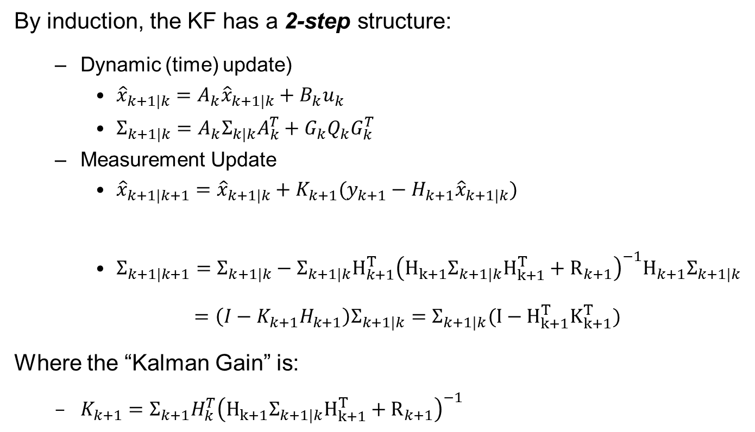
Recursive Construction of KF
By induction, the KF has a 2-step structure:
Dynamic (time) update)
${\hat{x}}_{k+1|k}=A_{k}{\hat{x}}_{k+1|k}+B_{k}u_{k}$
$Σ_{k+1|k}=A_{k}Σ_{k|k}A_{k}^{T}+G_{k}Q_{k}G_{k}^{T}$
Measurement Update
${\hat{x}}_{k+1|k+1}={\hat{x}}_{k+1|k}+K_{k+1}(y_{k+1}−H_{k+1}{\hat{x}}_{k+1|k})$
$Σ_{k+1|k+1}=Σ_{k+1|k}−Σ_{k+1|k}H_{k+1}^{T}{\left({H_{k+1}Σ_{k+1|k}H}_{k+1}^{T}+R_{k+1}\right)}^{−1}H_{k+1}Σ_{k+1|k}$
$=\left(I−K_{k+1}H_{k+1}\right)Σ_{k+1|k}=Σ_{k+1|k}(I−{H_{k+1}^{T}K}_{k+1}^{T})$
Where the “Kalman Gain” is:
$K_{k+1}=Σ_{k+1}H_{k}^{T}{\left({H_{k+1}Σ_{k+1|k}H}_{k+1}^{T}+R_{k+1}\right)}^{−1}$
“residual,” “innovation”
“Kalman Gain”
“How much do I trust the model?”
“How much do I trust the measurements?”

