Slide 1
Fixed Lag Smoothing (see Anderson & More 7.3)
Goal: is to develop an estimator for ${\hat{x}}_{k−N|k}$ for some N, assuming
$$x_{k+1}=A_{k}x_{k}+B_{k}u_{k}+η_{k}$$
$$y_{k}=H_{k}x_{k}+ω_{k}$$
(with zero mean white Gaussian noise). N is the time lag. I.e., we want to develop an estimate of the state N time steps ago, using all measurements up until current time $t_{k}$
Why:
We will show that $Σ_{k−N|k}≤Σ_{k−N|k−N}$
Use measurements $t_{k−N+1}, t_{k−N+2}, …, t_{k}$to improve estimation accuracy, at the expense of a time lag in the estimate
The method can also produce smoothed estimates for $x$ at $t_{k−N+1}, t_{k−N+2}, …, t_{k}$, i.e., at states within the “smoothing window”
The methodology can be useful template for other problems.
0

Slide 2
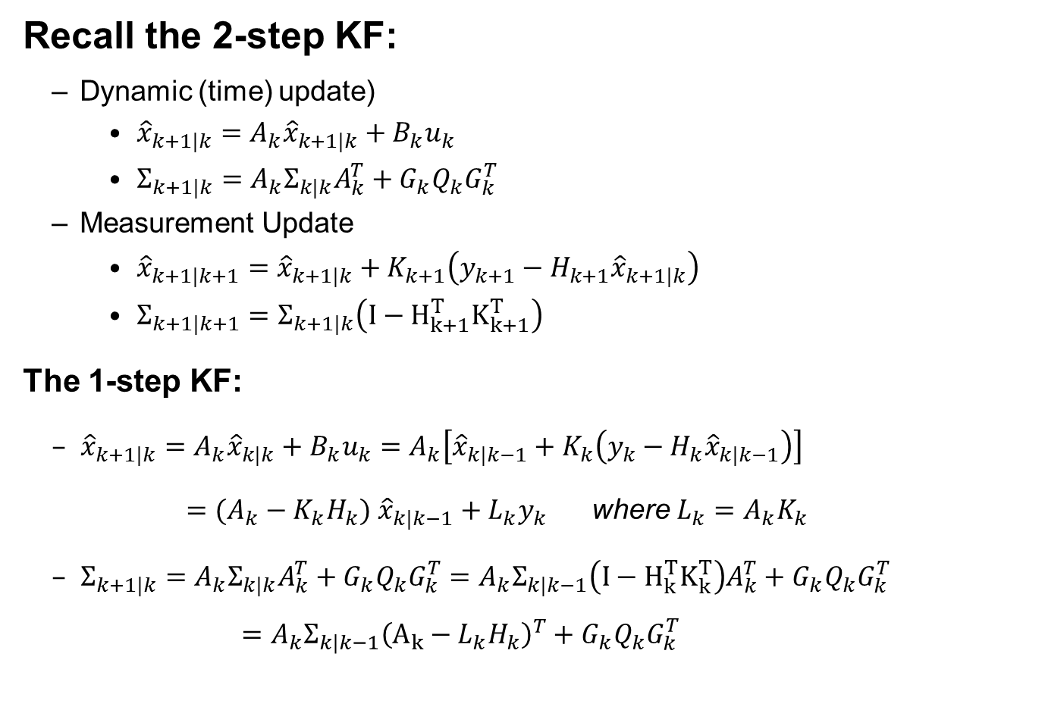
Background: the 1-step KF
Recall the 2-step KF:
Dynamic (time) update)
${\hat{x}}_{k+1|k}=A_{k}{\hat{x}}_{k+1|k}+B_{k}u_{k}$
$Σ_{k+1|k}=A_{k}Σ_{k|k}A_{k}^{T}+G_{k}Q_{k}G_{k}^{T}$
Measurement Update
${\hat{x}}_{k+1|k+1}={\hat{x}}_{k+1|k}+K_{k+1}\left(y_{k+1}−H_{k+1}{\hat{x}}_{k+1|k}\right)$
$Σ_{k+1|k+1}=Σ_{k+1|k}\left(I−{H_{k+1}^{T}K}_{k+1}^{T}\right)$
The 1-step KF:
${\hat{x}}_{k+1|k}=A_{k}{\hat{x}}_{k|k}+B_{k}u_{k}=A_{k}\left[{\hat{x}}_{k|k−1}+K_{k}\left(y_{k}−H_{k}{\hat{x}}_{k|k−1}\right)\right]$
$=(A_{k}−K_{k}H_{k})$ ${\hat{x}}_{k|k−1}+L_{k}y_{k}$ where $L_{k}=A_{k}K_{k}$
$Σ_{k+1|k}=A_{k}Σ_{k|k}A_{k}^{T}+G_{k}Q_{k}G_{k}^{T}=A_{k}Σ_{k|k−1}\left(I−{H_{k}^{T}K}_{k}^{T}\right)A_{k}^{T}+G_{k}Q_{k}G_{k}^{T}$
$$=A_{k}Σ_{k|k−1}{\left(A_{k}−L_{k}H_{k}\right)}^{T}+G_{k}Q_{k}G_{k}^{T}$$
$$K_{k+1}=Σ_{k+1|k}H_{k}^{T}{\left({H_{k+1}Σ_{k+1|k}H}_{k+1}^{T}+R_{k+1}\right)}^{−1}$$

Slide 3
The Augmented State Vector
Define an Augmented dynamical system:
$${\vec{X}}_{k+1}^{a}=\left[\begin{matrix}\begin{matrix}x_{k+1}^{(0)} \\ x_{k+1}^{(1)} \\ x_{k+1}^{(2)}\end{matrix} \\ \begin{matrix}⋮ \\ x_{k+1}^{(N+1)}\end{matrix}\end{matrix}\right]=\left[\begin{matrix}\begin{matrix}A_{k} & 0 & 0 \\ I & 0 & 0 \\ 0 & I & 0\end{matrix} & \begin{matrix}⋯ & 0 \\ ⋯ & 0 \\ ⋯ & 0\end{matrix} \\ \begin{matrix}⋮ & ⋮ & ⋱ \\ 0 & 0 & ⋯\end{matrix} & \begin{matrix}⋯ & ⋮ \\ I & 0\end{matrix}\end{matrix}\right]\left[\begin{matrix}\begin{matrix}x_{k}^{(0)} \\ x_{k}^{(1)} \\ x_{k}^{(2)}\end{matrix} \\ \begin{matrix}⋮ \\ x_{k}^{(N+1)}\end{matrix}\end{matrix}\right]+\left[\begin{matrix}\begin{matrix}G_{k} \\ 0 \\ 0\end{matrix} \\ \begin{matrix}⋮ \\ 0\end{matrix}\end{matrix}\right]η_{k}$$
$$y_{k}= \left[H_{k} 0 0 ⋯ 0\right]{\vec{X}}_{k}^{a}+ω_{k}$$
Where matrices $A_{k}, G_{k}, H_k$ and noises $η_{k}, ω_{k}$ come from original system.
The augmented state is a vector of time-shifted states
$x_{k+1}^{(0)}=A_{k}x_{k}^{(0)}+G_{k}η_{k}=A_{k}x_{k}+G_{k}η_{k}=$system state at $t_{k+1}$
${ x}_{k+1}^{(1)}=x_{k}^{(0)}=x_{k}=$system state at $t_{k}$
$x_{k+1}^{(2)}=x_{k}^{(1)}=x_{k}^{(0)}=x_{k−1}=$system state at $t_{k−1}$

Slide 4
The Augmented State Vector
$⋮$
${ x}_{k+1}^{(i)} =x_{k}^{(i−1)}=⋯=x_{k−i+1}=$system state at $t_{k−i+1}$
$⋮$
$x_{k+1}^{(N+1)}=x_{k}^{(N)}=x_{k−1}^{(N−1)}=⋯=x_{k−N}=$system state at $t_{k−N}$
So, the last component of the augmented state (and its associated covariance) is the state for which we wish to produce a smoothed estimate (and its associated estimate uncertainty).
Key Idea: Since the augmented system satisfies all of the requirements for a discrete time linear system with zero-mean, white Gaussian noise, we can construct a Kalman filter for the augmented system, and then isolate the terms of interest in the resulting filter equations.

Slide 5

The Variance Reduction Property
$$Σ_{k−N|k}= Σ_{k−N|k−N−1}− \sum_{l=k−N}^{k}{Σ_{l|l−1}^{(q,0)}}H_{l}^{T}{\left[H_{l}Σ_{l|l−1}H_{l}^{T}+R_{l}\right]}^{−1}H_{l}Σ_{l|l−1}^{{\left(q,0\right)}^{T}}$$
where: $q=l−k+N$
Reduction in estimate uncertainty due to “smoothing”

