Slide 1
CS/EE/ME 75(C): Week 1 (2)
1) Our goal: Develop simulations for RC Car and Drive-o-copter
  Many control, planning, autonomy algorithms can be simulated
  Will simplify “Technical lectures” will be mainly asynchronous.
2) First Steps
  We need to get everyone to the point where they can write basic ROS programs.
  Learn how to simulate using Gazebo, and visualize using RVIS
  Write a URDF description of your vehicles
  Learn how to download the JPL simulation environment for a Husky
    Has multiple simulation environments, such as tunnel, cave, building
    Linked to all of JPL autonomy algorithms
  Link your models to the JPL simulation

Slide 2
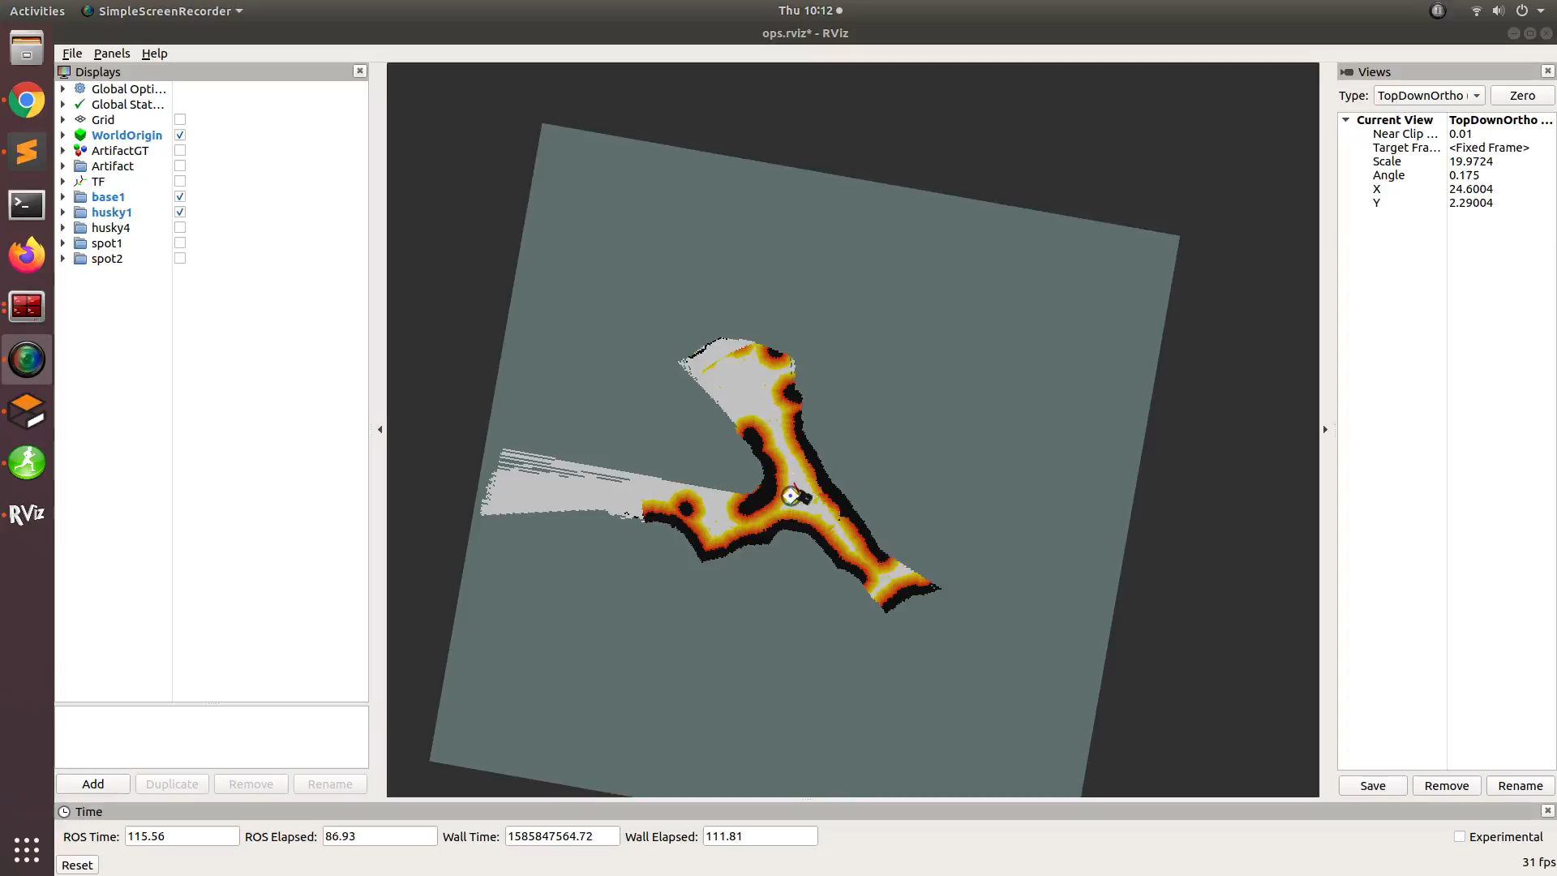
CS/EE/ME 75(C): Week 1 (2)
Question: where is leading edge of everyone’s ROS skills?

Slide 3
Homework: see course web site:
  Watch some YouTube videos (from ETH) on ROS
  Continue with ROS Tutorial Page exercises
Next Up:
  Gazebo and Rviz Tutorials
  Tutorial on downloading JPL simulation environment (you will download it before you fully understand it)
  Building a simple simulation (before you try full JPL simulation)

