Slide 1
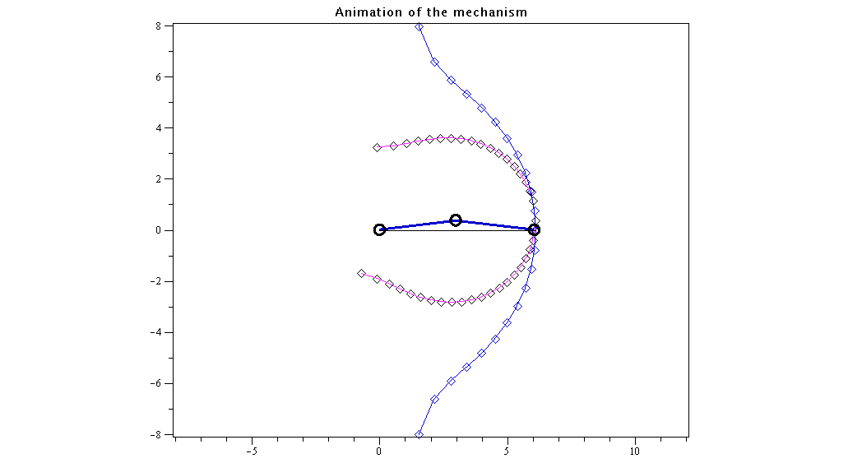
Fixed & Moving Centrodes of a Slider-Crank
This end of body rotating about point on this line
Instantaneous Center of Rotation (centrode)
This end of body rotating about point on this line
Analyze this body

Slide 2
C
Instantaneous Pole Location
P
B
Moving Centrode
y
θ
x
A
Fixed Centrode
Elliptical Path of Point C

