Slide 1
Gears
Gears simply change the parameters of mechanical power
Pitch-Line Velocity
P
r₁
r₂
pinion
gear

Slide 2
Tooth Forces
T₂
T₁
F₂
r₁
r₂
F₁

Slide 3
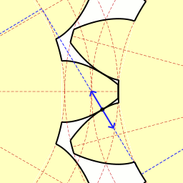
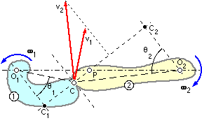
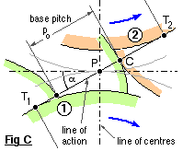
Normal velocity must match. Using similar triangles
v₂ cosθ₂ = v₁ cosθ₁
where v₁ = ω₁ . O₁C ; v₂ = ω₂ . O₂C
Want constant rotation rate ratio
ω₂ /ω₁ = v₂ . O₁C/v₁ . O₂C = O₁C.cosθ₁ /O₂C.cosθ₂ = O₁ C₁ /O₂ C₂ = O₁ P / O₂ P
Point P must be fixed

Slide 4
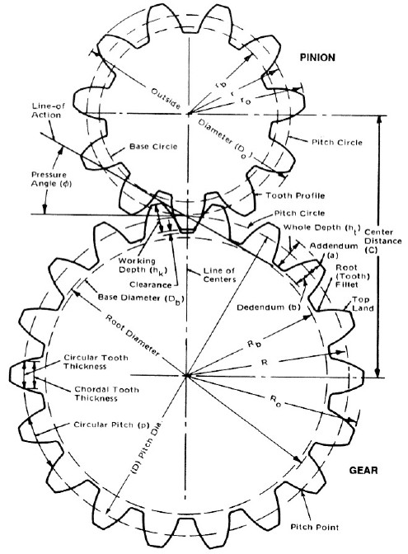
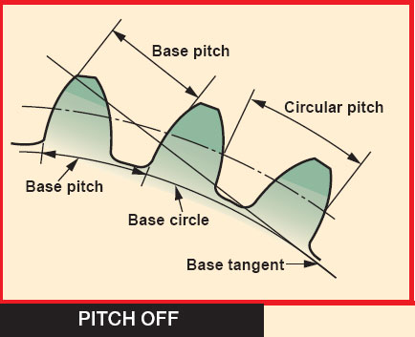
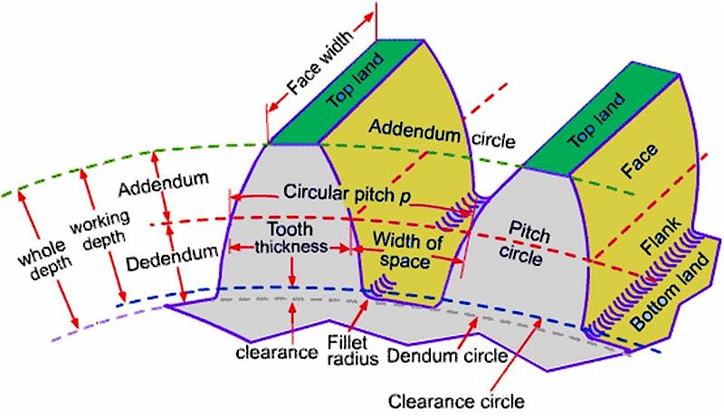
Involute Teeth Gear Geometries

Slide 5
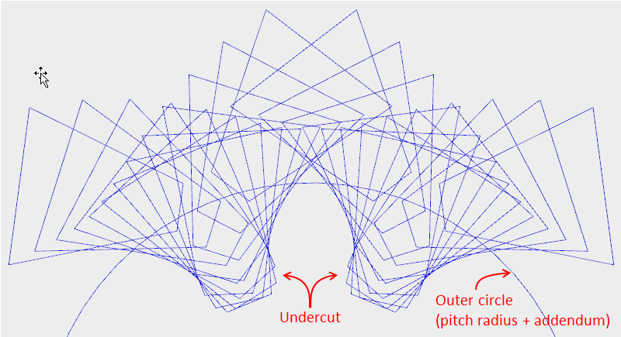
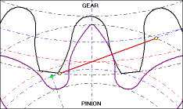
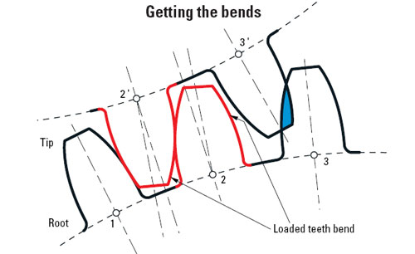
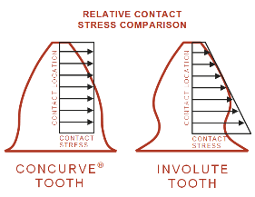

Slide 6
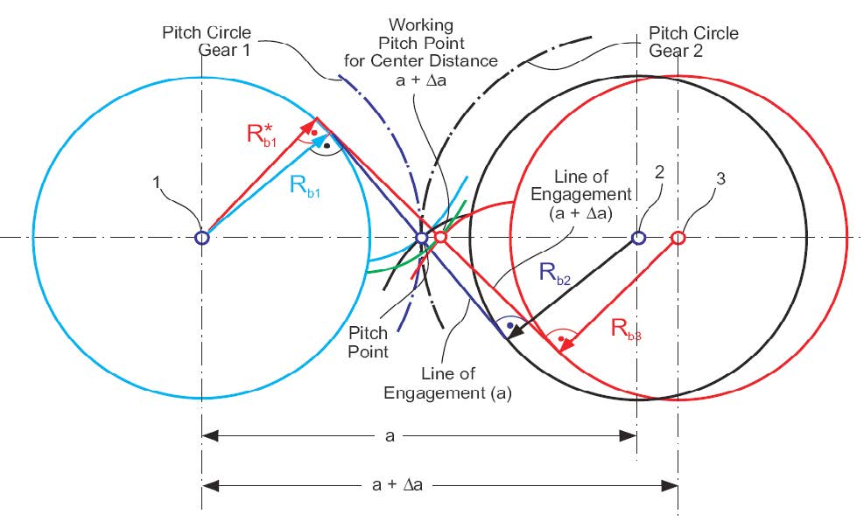
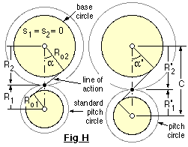

Slide 7
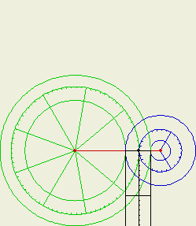
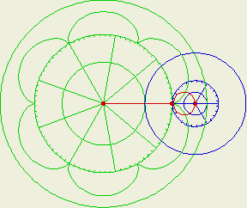
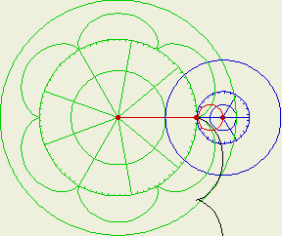
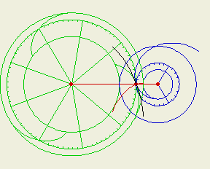
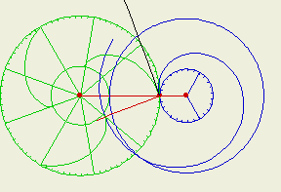
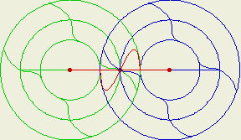

Slide 8
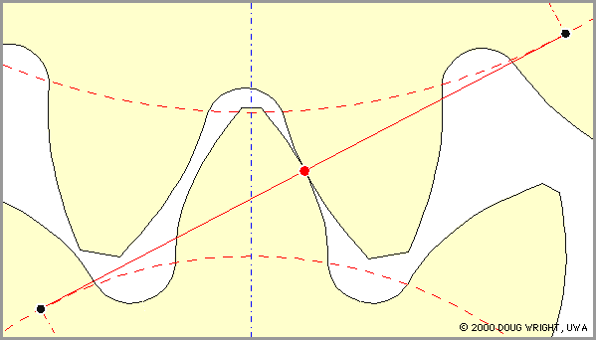
Effect of Errors
Shafts at spec.
distance
Shafts farther apart than spec.

